Slide 1

AFT NATIONAL
Emergency Preparedness and Response
A Union Approach
Notes:
Kelly
Sara puts resource handout in the chat.

Slide 3

Objectives
After this module, you will be able to:
  Understand why workers and their unions should play an integral part of emergency preparedness planning
  Recognize the basic components of emergency preparedness planning
  Learn how to evaluate your employer's plan as it relates to emergency preparedness planning
Notes:
SM—
We would like to know about you. Please put your name, where you work, and where you live in the chat. Thanks.

Slide 4


The American Federation of Teachers Nurses and Health Professionals is accredited as a provider of nursing continuing professional development by the American Nurses Credentialing Center's Commission on Accreditation, P#0003
The presenters declare there is no conflict of interest.
Contact hour requirements
Send an email to smarkle@aft.org with your name and if you are an RN.
Stay on through the first 60 minutes.
Complete the evaluation (QR code and also posted in the chat at the completion of the session.
Notes:
SME
For those of you who are RNs and are interested in earning a contact hour for participating in this webinar, I want to let you know what you have to do.
Please email me at smarkle@aft.org so we have your contact information.
Please include your name and whether you are an RN.
You must stay on to the end.
You will see a QR code to a very short evaluation, or you can use the link I will put into the chat. You must complete the evaluation to earn the credit. There will be a code word at the completion of the webinar which you must know to earn the credit.
We will email you a certificate—it is not an automated process, please allow us a few days.

Slide 5
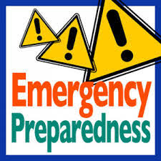

Is Emergency Planning a Union Issue?
OSHA and other agencies like FEMA and Homeland Security believe that it is beneficial to include employees in the development of Emergency Action Plans because their commitment and support are critical to the plan’s success.
Notes:
KW
The concept of emergency preparedness is defined as:
“a continuous cycle of planning, organizing, training, equipping, exercising, evaluating, and taking corrective active in an effort to ensure effective coordination during incident response” (National Incident Management System).

Slide 6
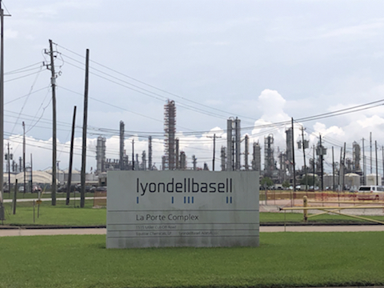
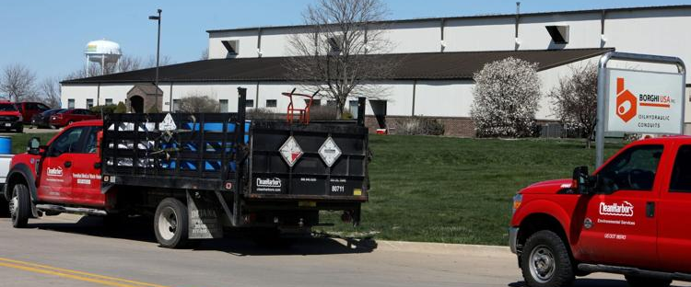
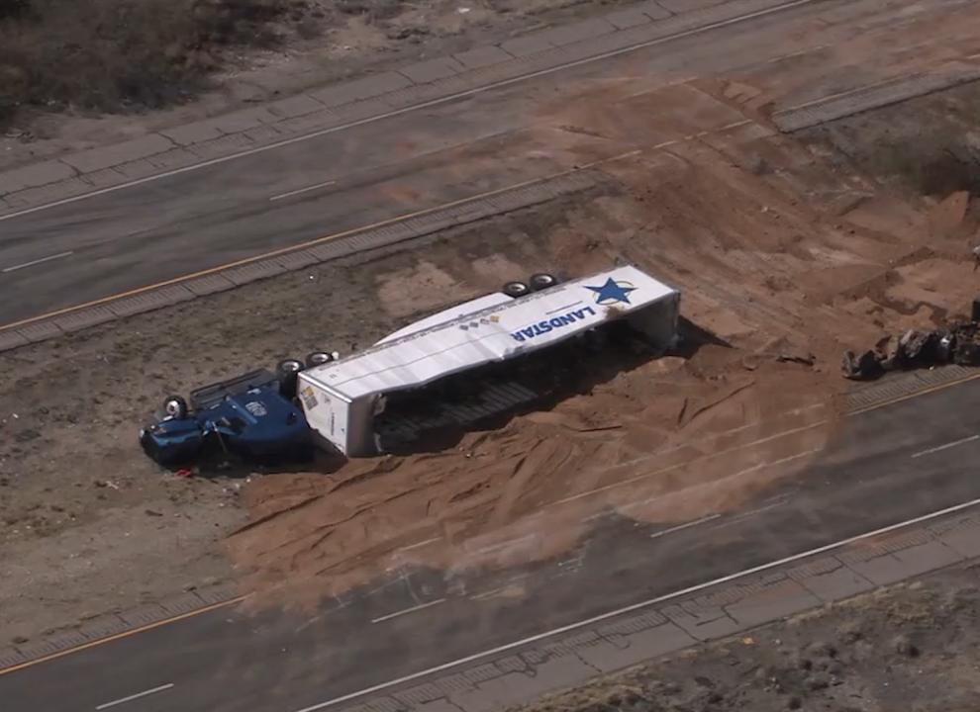
Not a New Problem
Notes:
On July 27, 2021, a release of 100,000 pounds of acetic acid during a maintenance event at the LyondellBasell facility in La Porte, TX, resulted in fatal injuries to two contract employees and 30 other personnel being transported to medical facilities for evaluation and/or treatment.
On April 12, 2022 a pipe leak at the Borghi Plant in Iowa caused a massive spread of hydrochloric acid to spread throughout the floor of the plant. Despite regulation requiring the plant to shut down and call in hazmat crews and the fire department, the plant remained in production. Employees said the plant attempted to use shop vacuums and other in-house methods to clean up the spill. Employees said that several crew members either walked off the job while others left to seek medical attention for becoming ill or injured after being exposed to the chemicals.
On Feb 14, 2023 a truck carrying liquid nitric acid crashed in Tucson, causing a complete shutdown of Interstate 10 and evacuation and shelter-in-place orders. Authorities ordered a shelter-in-place for a three-mile perimeter around the incident. Emblazoned on the side of that shipping container holding the nitric acid is the name Landstar. The driver of the truck, which was hauling a box trailer, died sometime after the crash.

Slide 7
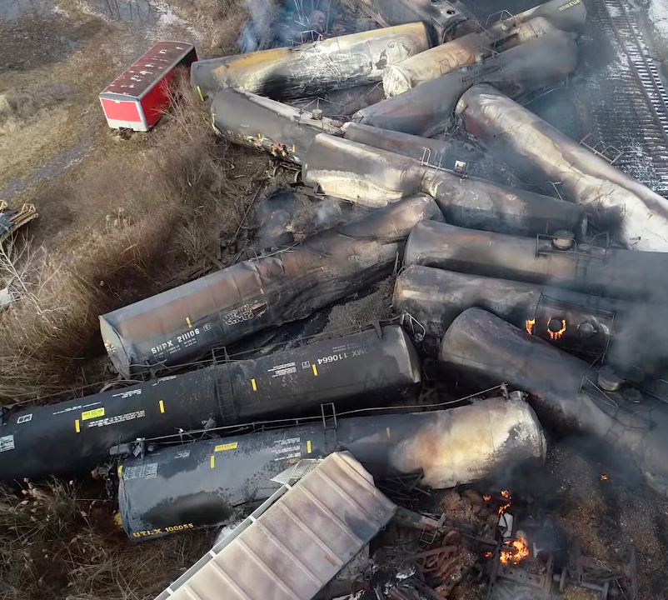
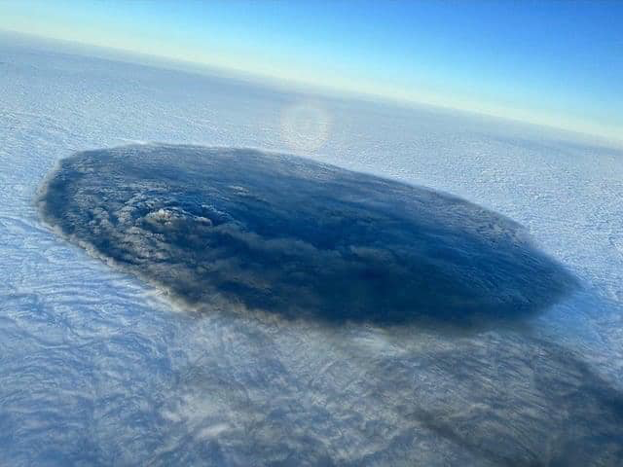
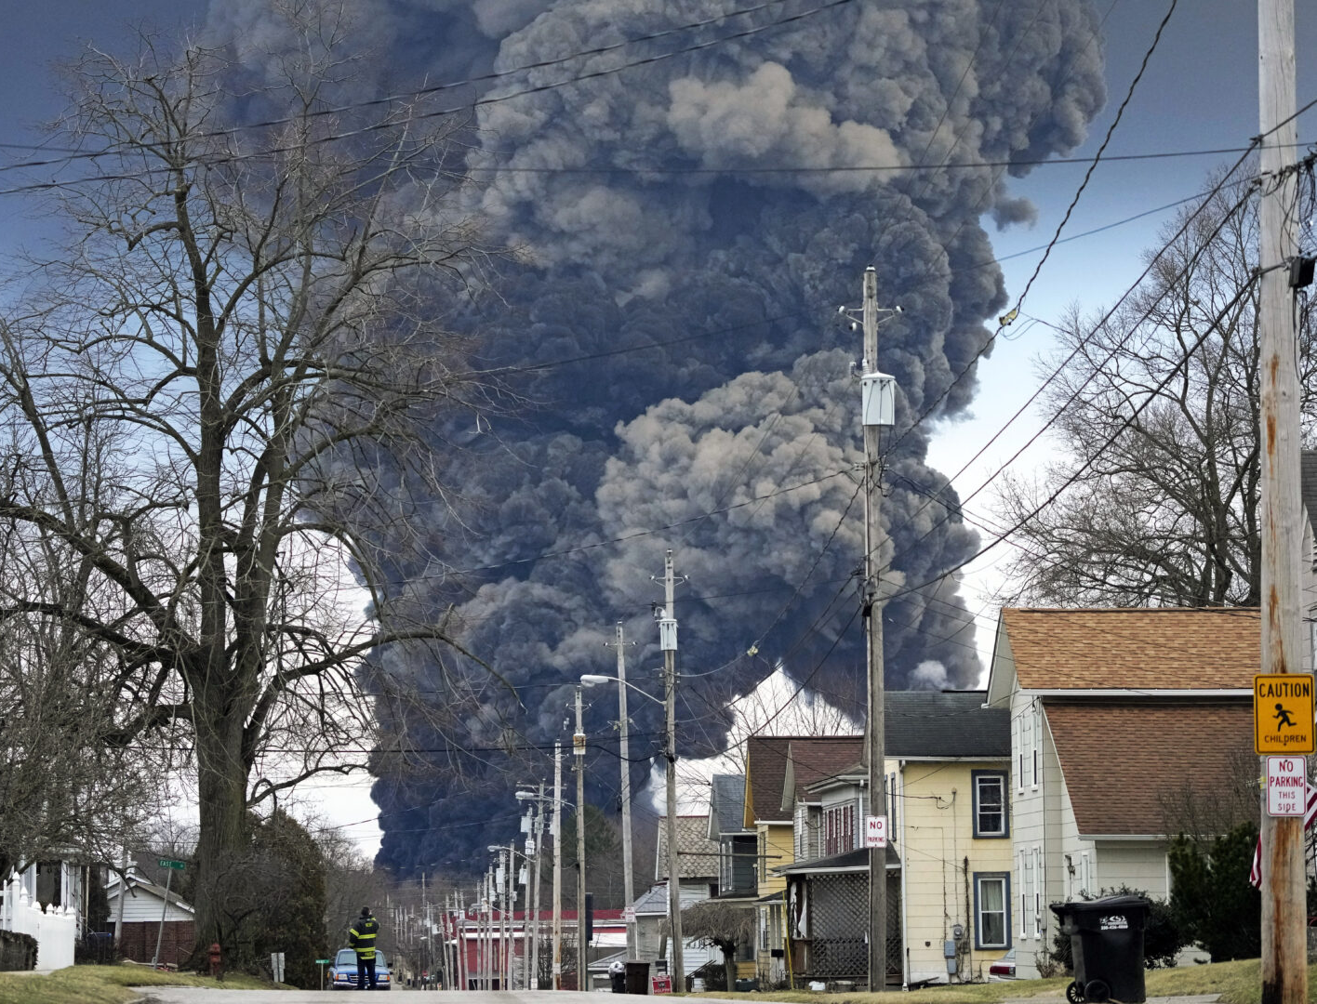
East Palestine, OH:
What We Know
East Palestine Health Clinic
FEMA
Air Monitoring
Residential Well Sampling
Waterways
Waste Removal
Notes:
As of 2/22/23
Municipal Water Sampling
Last week, test results confirmed that East Palestine’s municipal water was free from contaminants associated with the derailment. Out of an abundance of caution, the Ohio EPA will independently test the municipal water once a week to ensure that this water source remains clean.
Private Well Sampling
The Columbiana County Health Department reports that it has sampled 74 private wells in the East Palestine area. Final testing results are pending. Those whose drinking water is sourced from a private well are encouraged to drink bottled water until testing results are returned. To schedule testing for your private well, call 330-849-3919.
Air Monitoring
The U.S. EPA reported that they have conducted indoor air testing at a total of 560 homes. No contaminants associated with the derailment were detected. Those living in East Palestine who have not yet requested free air sampling can call 330-849-3919. Outdoor air monitoring is ongoing with 20 air monitors in the area. These monitors have not detected contaminants associated with the derailment.
Surface Water Cleanup
The contaminated section of Sulphur Run near the derailment site remains dammed to the east and west to prevent contamination of other water bodies. Clean creek water at the eastern dam continues to be funneled away before entering the contaminated area and is then released back into Sulphur Run at the western dam.
Aeration, the process of injecting oxygen into the water to treat contamination, also remains underway on Sulphur Run. Aeration drives chemicals to the water's surface, which are then extracted from the water. More than 1.6 million gallons of contaminants and contaminated water associated with the derailment have been removed from the area.
The quality of Leslie Run continues to improve. The most recent test results available, which are from samples taken on February 15, show very low levels of two contaminants, butyl acrylate and ethyl hexyl acrylate. Tests from North Fork Little Beaver Creek show much lower levels of ethyl hexyl acrylate and no traces of butyl acrylate. No vinyl chloride has been detected in any of these waterways.
The Ohio River Valley Water Sanitation Commission is no longer detecting contaminates related to the derailment in the Ohio River.
Soil Removal
To date, approximately 4,588 cubic yards of contaminated soil have been removed from the immediate area of the derailment.
Bureau of Workers' Compensation Claims
The Ohio Bureau of Workers’ Compensation has created a specialized team to specifically handle any workers’ compensation claims related to the derailment. These claims will be subject to the same standards, rules, and laws as any other claim within the jurisdiction of Ohio but will be administered by staff members with specialized knowledge related to toxic substance/harmful physical agent exposure. All claim-related inquiries may be directed to Sarah Shackelford at Sarah.S.2@bwc.state.oh.us or Wilma Rhone-Perez Wilma.P.1@bwc.state.oh.us

Slide 8
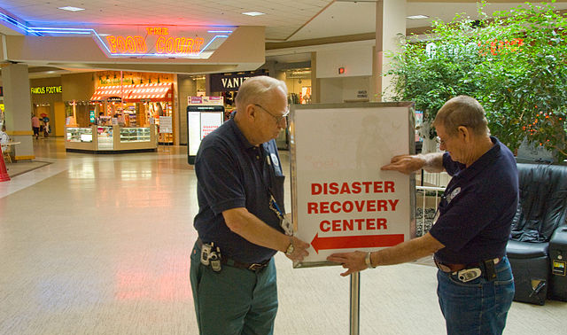
Response to Recovery:
Expectations Moving Forward
Assess the Injury
Plan the Restoration
Hold Polluters Accountable
Restore the Environment
Notes:
KW
Even though it has been nearly a month since the train derailment, federal, state and local governments are still in their response mode. Recovery will be the next step.
We are uncertain as to what the plan will look like, however, most recovery plans look something like this:
Assess the Injury: Quantify injuries to the environment, including lost recreational uses, by conducting scientific and economic studies
Plan the Restoration: Develop a restoration plan that identifies projects and outlines the best methods to restore the impacted environment
Hold Polluters Accountable: Ensure that responsible parties pay the costs of assessing injuries and restoring the environment
Restore the Environment: Implement projects to restore habitats and resources to the condition they would have been in had the pollution not occurred

Slide 9


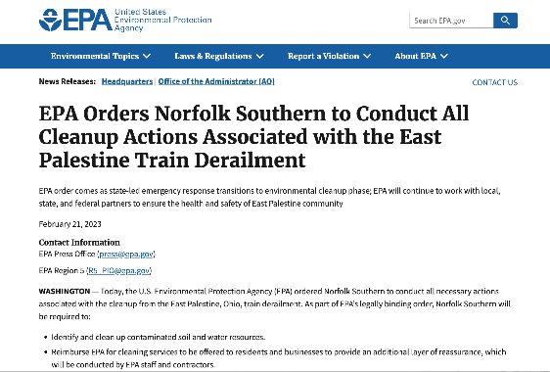
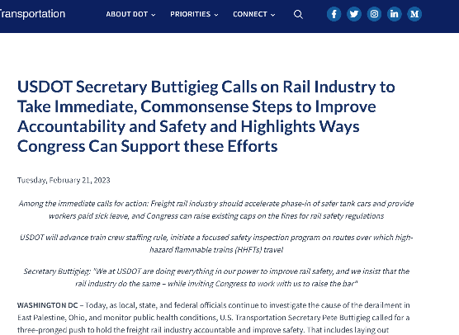
Notes:
Summarize each but they will have them as attachments.

Slide 10
Visit the U.S. EPA Information Page on the East Palestine Train Derailment.
Visit the Ohio EPA Information Page on the East Palestine Train Derailment.
Visit the Ohio Emergency Management Agency on the East Palestine Train Derailment.
Assistance for evacuated residents (compiled from Ohio EMA webpage):
  U.S. EPA Information Line: 215-814-2400
  Columbiana County Emergency Management Agency: 330-424-7139
  Norfolk Southern Family Assistance Center: 800-230-7049
  Contact the Train Derailment Hotline for questions about odors, fumes, animals, health and other concerns: 234-542-6474
  Residents that have questions about water quality of their private wells, contact the Columbiana County Health Department: 330-424-0272
  Residents that wish to request air quality monitoring at their home (for residences within the 1-mile evacuation zone, only): 330-849-3919

Slide 11
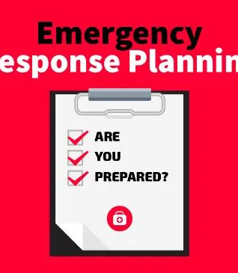
Best Practices for Emergency Management Plans …
Identify
unique threats or hazards at your workplace
Have
a designated chain of command
Include
actions and response protocols for crisis situations
Provide
a communication process for all key stakeholders
Allow
for practice drills and evaluation of how well they were conducted
Notes:
KW
Top 5 things – going though each in more detail.

Slide 12


Planning Principles
Planning must:
  Be supported by senior leadership
  Use an assessment to customize plans to the individual workplace.
  Consider all threats and hazards.
  Provide for the access and functional needs of the whole workplace community.
  Consider all settings and all times.
  Considers the individual preparedness of staff.
Creating and revising a model emergency operations plan is done by following a collaborative process.
Notes:
KW

Slide 13

Emergency Planning & Response:
"All Hazards" Approach
An Emergency is an unforeseen situation that:
Threatens employees, customers, or the public;
Disrupts or shuts down operations; or
Causes physical or environmental damage.
Notes:
KW
Considering all possible events
Planning for situations of high probability as well as unique events
Providing for resources to meet the event
Recovering and restoring to normal
Fire
Natural disasters
Chemical spills
Severe Weather
Bomb Threats
Intruders
Community incidents
Structure or facilities failure
Bullying/Fighting/Assaults/Homicides/Weapons
Pandemic Influenza or other Public Health Crisis

Slide 14

Have You Seen Your Employer's Plan?
Notes:
AB

Slide 15
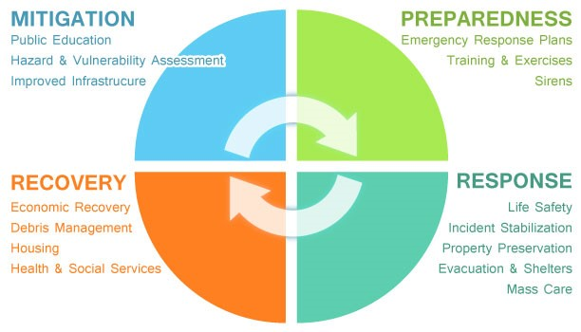
Notes:
AB

Slide 16

Mitigation – Hazard and Threat Assessments
The core planning team should include representatives from across the workplace, including individuals and organizations that serve and represent the interests of staff.
Local and county emergency responders should be included.
The planning team is tasked with identifying possible threats and hazards within the workplace and the surrounding community, and assesses the risk and vulnerabilities posed by those threats and hazards.
Notes:
AB
Local and county agencies that have a knowledge of threats and hazards include, but are not limited to, emergency management offices, fire and police departments, as well as local organizations and community groups (e.g., local chapter of the American Red Cross, CERT), utilities, and other businesses that can provide helpful information.

Slide 17

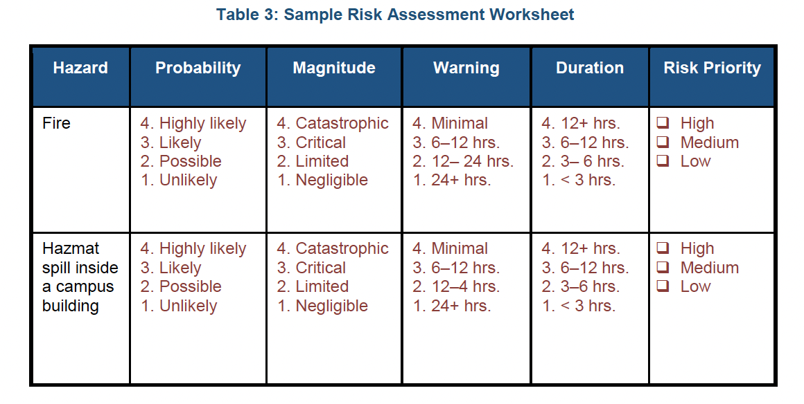
Mitigation - Evaluating and Prioritizing Risks
Once an initial set of threats and hazards have been identified the planning team should evaluate and prioritize the risks posed by threats and hazards.
Notes:
AB
Evaluating risk entails understanding the probability that the specific threat or hazard will occur; the effects it will likely have, including the severity of the impact; the time the employer will have to warn staff about the threat or hazard; and how long it may last.

Slide 18

Preparedness – Developing a Response Plan
The planning team should develop specific courses of action (response protocols) for each threat or hazard identified – for before, during, and after each threat and hazard.
For each situation:
  Determine the amount of time available to respond (can be minutes to days)
  Identify decision points (what triggers the next response)
  Develop courses of action (who, when, what, how)
Notes:
AB
The Threat- and Hazard-Specific Responses specifies the goals, objectives, and courses of action that an employer will follow to address a particular type of threat or hazard (e.g., hurricane, active shooter) and discuss how the employer manages a function before, during, and after an emergency.

Slide 19
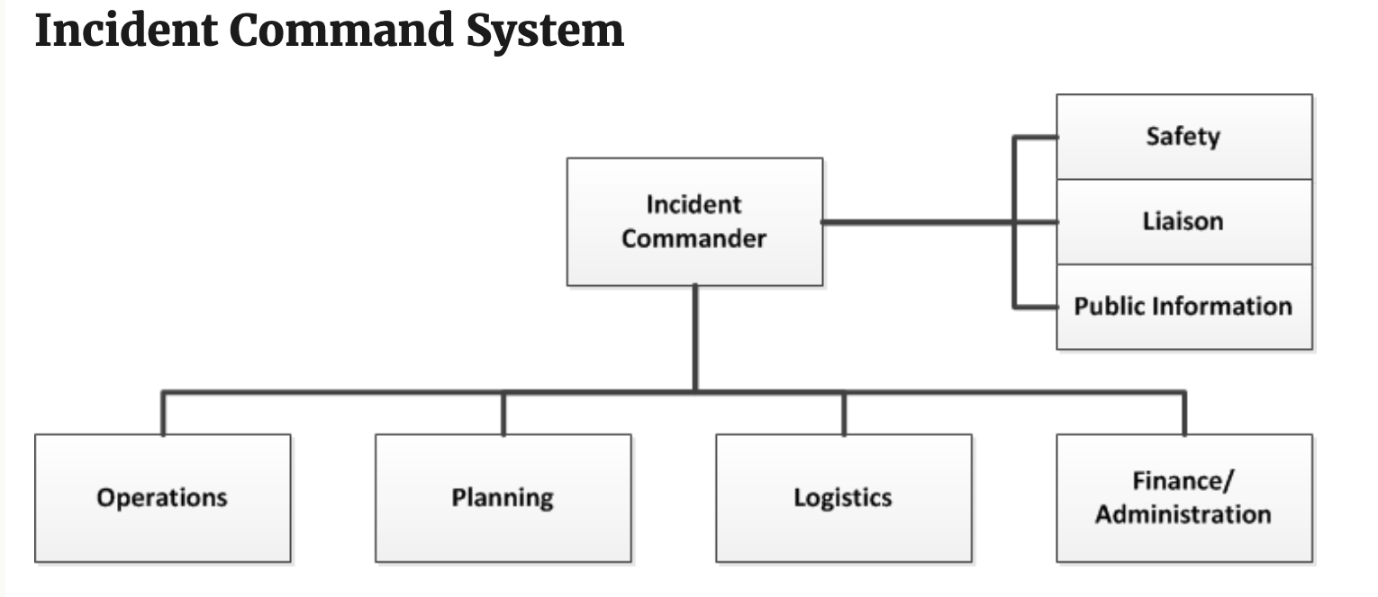
Preparedness: Incident Command Structure (ICS)
The Incident Command System (ICS) is a systematic tool used for the command, control, and coordination of an emergency response. ICS allows agencies to work together using common terminology and operating procedures for controlling personnel, facilities, equipment, and communications at a single incident scene.
Notes:
AB
Who Responds:
Dictated by the event
Numbers impacted
Nature of impacting material

Slide 20
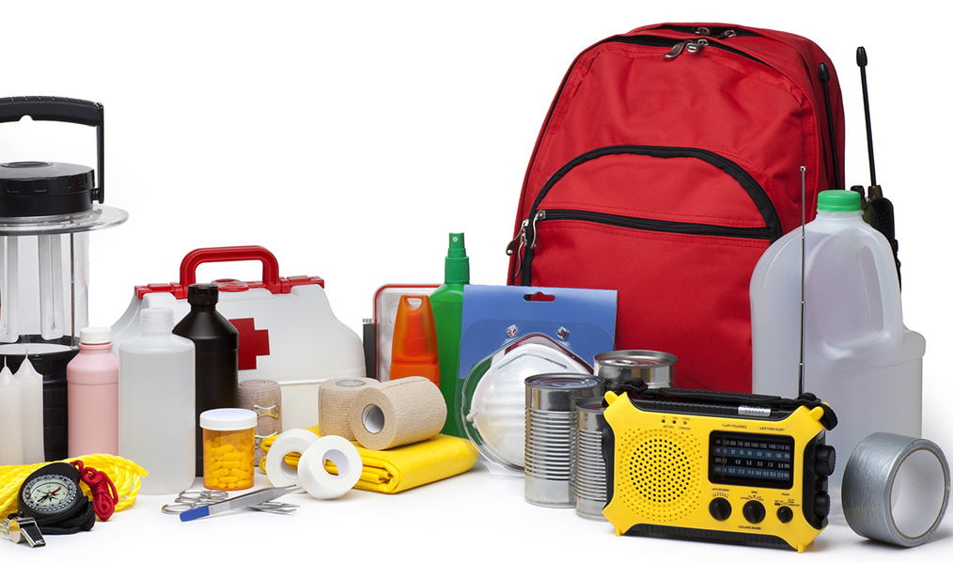
Supplies and Resources
Workplace Supplies
Safety glasses, goggles, or face shields for eye protection
Hard hats and safety shoes for head and foot protection
Proper respirators
Chemical suits, gloves, hoods, and boots for body protection from chemicals
Any other special equipment or warning devices necessary for hazards associated with the worksite
Specialty equipment for moving people and patients
Notes:
Emergencies can create a variety of hazards for workers in the impacted area. Preparing before an emergency incident plays a vital role in ensuring that employers and workers have the necessary equipment, know where to go, and know how to keep themselves safe when an emergency occurs.
Workplace Supplies
Safety glasses, goggles, or face shields for eye protection
Hard hats and safety shoes for head and foot protection
Proper respirators
Chemical suits, gloves, hoods, and boots for body protection from chemicals
Special body protection (e.g., fire-retardant clothing) for abnormal environmental conditions, such as extreme temperatures
Any other special equipment or warning devices necessary for hazards associated with the worksite
Specialty equipment for moving people and patients
Other Supplies (general public)
Masks (for everyone ages 2 and above), soap, hand sanitizer, disinfecting wipes to disinfect surfaces
Prescription medications. About half of all Americans take a prescription medicine every day. An emergency can make it difficult for them to refill their prescription or to find an open pharmacy. Organize and protect your prescriptions, over-the-counter drugs, and vitamins to prepare for an emergency.
Non-prescription medications such as pain relievers, anti-diarrhea medication, antacids or laxatives
Prescription eyeglasses and contact lens solution
Infant formula, bottles, diapers, wipes and diaper rash cream
Pet food and extra water for your pet
Cash or traveler's checks
Important family documents such as copies of insurance policies, identification and bank account records saved electronically or in a waterproof, portable container
Sleeping bag or warm blanket for each person
Complete change of clothing appropriate for your climate and sturdy shoes
Fire extinguisher
Matches in a waterproof container
Feminine supplies and personal hygiene items
Mess kits, paper cups, plates, paper towels and plastic utensils
Paper and pencil
Books, games, puzzles or other activities for children
Water (one gallon per person per day for several days, for drinking and sanitation)
Food (at least a several-day supply of non-perishable food)
Battery-powered or hand crank radio and a NOAA Weather Radio with tone alert
Flashlight
First aid kit
Extra batteries
Whistle (to signal for help)
Dust mask (to help filter contaminated air)
Plastic sheeting and duct tape (to shelter in place)
Moist towelettes, garbage bags and plastic ties (for personal sanitation)
Wrench or pliers (to turn off utilities)
Manual can opener (for food)
Local maps
Cell phone with chargers and a backup battery

Slide 21

Preparedness: Implementing the Plan
Training!
  Everyone involved in the plan needs to know their roles and responsibilities before, during and after an emergency.
  Everyone at the workplace should be educated and familiarized with the plan at least annually.
    Visit evacuation sites and where specific areas will be set up (reunification, triage, media, etc.)
    Develop reference guides with information; post throughout buildings.
    Include emergency responders and other community partners in training.
Notes:
AB

Slide 22
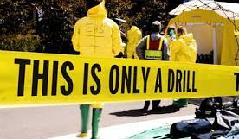
Preparedness: Practice, Practice, Practice
The more a plan is practiced, and stakeholders are trained on the plan, the more effectively they will be able to act before, during, and after an emergency to lessen the impact on life and property.
Exercises provide opportunities to practice with community partners including first responders and local emergency management as well as to identify gaps and weaknesses in the plan.
Types of Exercises:
Tabletop: Small-group discussions that walk through a scenario and the courses of actions needed to take before, during, and after an emergency.
Drills: In partnership with first responders, drills practice on site to practice responding to a scenario.
Notes:
AB
Include first responders (e.g., law enforcement officers, EMS personnel, fire department officials), local emergency managers, and public and mental health officials;
Include additional stakeholders such as community organizations;
Communicate information in advance to avoid confusion and concern;
Exercise under different and non-ideal conditions (e.g., time of day, weather, absence of key personnel and various workplace events);
Be consistent with common emergency management terminology
Evacuation Drills
Reverse Evacuation Drills
Lockdown
Shelter-in-Place
Full-Scale with Emergency Responders

Slide 23

Response
Activities and programs designed to address the immediate and short-term effects of the onset of an emergency or disaster – basically putting the plan into ACTION!
Notes:
AB
The response phase includes the search and rescue; fulfilling basic humanitarian needs of victims ; assistance by regional, national and international bodies etc.

Slide 24
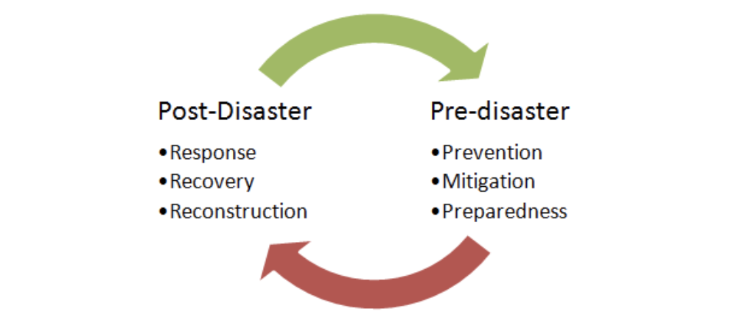
Recovery
Long-term activities and programs beyond the initial crisis period of an emergency or disaster designed to return all systems to normal status or to reconstitute these systems to a new, less vulnerable condition.
Notes:
AB
Recovery phase starts after the immediate threat to human life has subsided. The immediate goal of the recovery phase is to bring the affected area back to some degree of normalcy. During reconstruction, the location or construction material of the property is considered.

Slide 25

Recovery: Debriefing after an Exercise and/or Incident
  Debrief and develop an after-action report that evaluates results, identifies gaps or shortfalls, and documents lessons learned.
  Discuss how the plan and procedures will be modified, if needed, and specify who has the responsibility for modifying the plan.
  Participants should include planning committee plus first responders, and other key stakeholders.
Notes:
AB
Make the most of lessons learned
Critique response for fact-finding NOT fault-finding
Determine plan changes
Train staff on changes

Slide 26

Healthcare Specific Information

Slide 27

Hospitals are in Unique Situations
Plans need to address:
Emergencies from the community and emergencies within the facility
Potential sudden influx of patients
Little to no information on hazardous materials on patients
Hospitals need to prepare as individual institutions and as part of the emergency response community
Notes:
SM
If a hospital is part of a health care system and participates in the system's emergency response plan:
-the hospital has to actively participate in planning
-the plan must address the unique needs of the hospital and community
-the hospital must be capable of enacting the system's plan

Slide 28
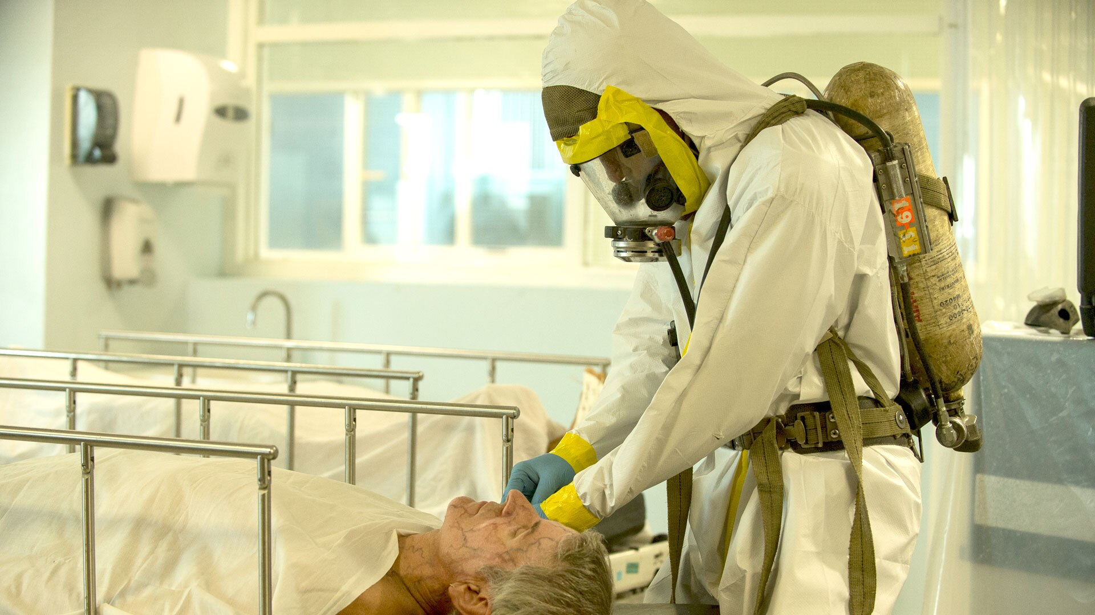
HAZWOPER and Healthcare Workers
Did you receive any specific instructions for receiving patients with symptoms associated with the train derailment?​
Were you provided any additional protections when receiving patients with symptoms associated with the train derailment?
Notes:
Hazardous Waste Operations and Emergency Response (HAZWOPER)
Healthcare workers risk occupational exposure to chemical, biological, or radiological materials when hospitals receive patients contaminated with these substances during mass casualty incidents. Such incidents could be associated with man-made (intentional or unintentional) or natural disasters.
Healthcare workers at a hospital receiving contaminated victims for treatment are called first receivers. This group is a subset of first responders (e.g., firefighters, law enforcement, HAZMAT teams, and ambulance service personnel). The extent of the hazard to the hospital-based first receivers can differ from that at the release site.
OSHA has clarified when and how the HAZWOPER standard applies to first receivers.

Slide 29

Hazardous Waste Operations and Emergency Response
Key Points:
Initial and annual training requirements
PPE based on hazards present or likely to be present
Decontamination equipment and procedures
Communication between the incident site and hospital personnel
Personnel roles and responsibilities
Notes:
KW
The HAZWOPER standard is complex and the EPA also enforces OSHA standard for local and state employees in OSHA absence.
The standard requires:
Pre-emergency drills;
Practice sessions with other local emergency response organizations using the ICS;
Personnel roles and responsibilities, including who will be in charge of directing the response, training, and communications;
Lines of authority and communication between the incident site and hospital personnel regarding hazards and potential contamination;
Designation of a decontamination team, including emergency department physicians, nurses, aides, and support personnel;
Description of the hospital’s system for immediately accessing information on toxic materials;
Evacuation plan and designation of alternative facilities that could provide treatment in case of contamination of the hospital’s Emergency Department;
Plan for managing emergency treatment of non-contaminated patients;
Decontamination equipment, procedures, and designation of decontamination areas (either indoors or outdoors);
Hospital staff use of PPE based on hazards present or likely to be present, routes of exposure, degree of contact, and each individual’s specific tasks;
Location and quantity of PPE;
Prevention of cross-contamination by airborne substances via the hospital’s ventilation system or other means;
Prevention of cross-contamination by hazardous substances that are not airborne (e.g., surface contamination);
Air monitoring to ensure that the facility is safe for occupancy following treatment of contaminated patients; and
Post-emergency critique and follow-up of drills and actual emergencies.
Initial and annual training requirements range from 8 hours, up to 24 hours depending on a workers anticipated role in the response.

Slide 30
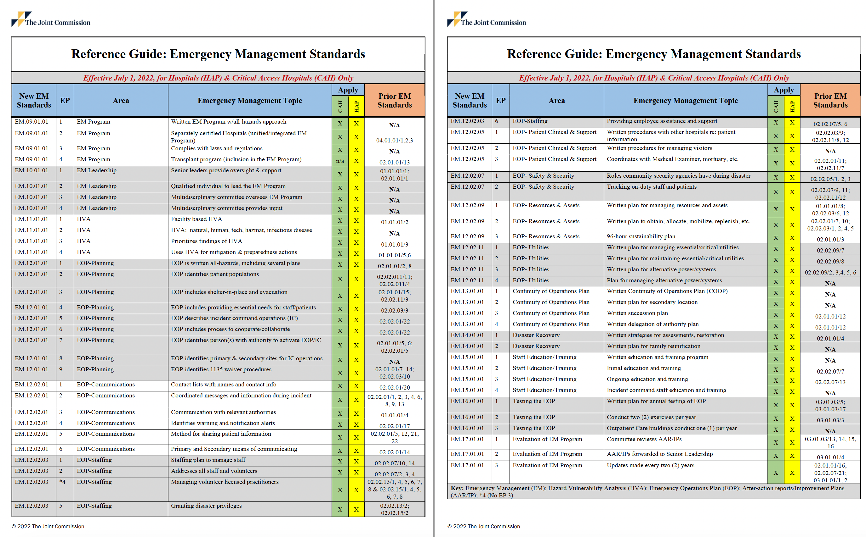
Hospitals are Key Players in Emergency Response
The Joint Commission updated the Emergency Management standard requiring a written EM Program with an all-hazards approach. Leadership must:
Provide oversight & support
Appoint a qualified individual to lead the EM Program
Appoint a multidisciplinary committee to oversee EM Program and provide input.
(hand out Reference Guide: Emergency Management Standards)
Notes:
SM
Joint Commission updated the Emergency Management rule in 2022.

Slide 31

Specific Joint Commission Requirements
Staffing: Bringing in off duty staff, travelers, and volunteers. They must verify licensure from volunteers within 72 hours from when they begin.
Patient care: Continuity of care, transfer of patients, rapid acquisition of supplies and patient records.
Heightened security: Tracking patients, minimizing hazard exposures for staff, coordination with police and National Guard.
This Photo by Unknown author is licensed under CC BY.

Slide 32

Managing resources:
Tracking, monitoring, locating patient care supplies, PPE, potable and non-potable water, fuel, oxygen, etc.
Written plan for mobilizing, allocating, replenishing, and conserving supplies.
Must address how they will make the supplies last for 96 hours—but they are not required to be fully self-sufficient.
This Photo by Unknown author is licensed under CC BY.

Slide 33
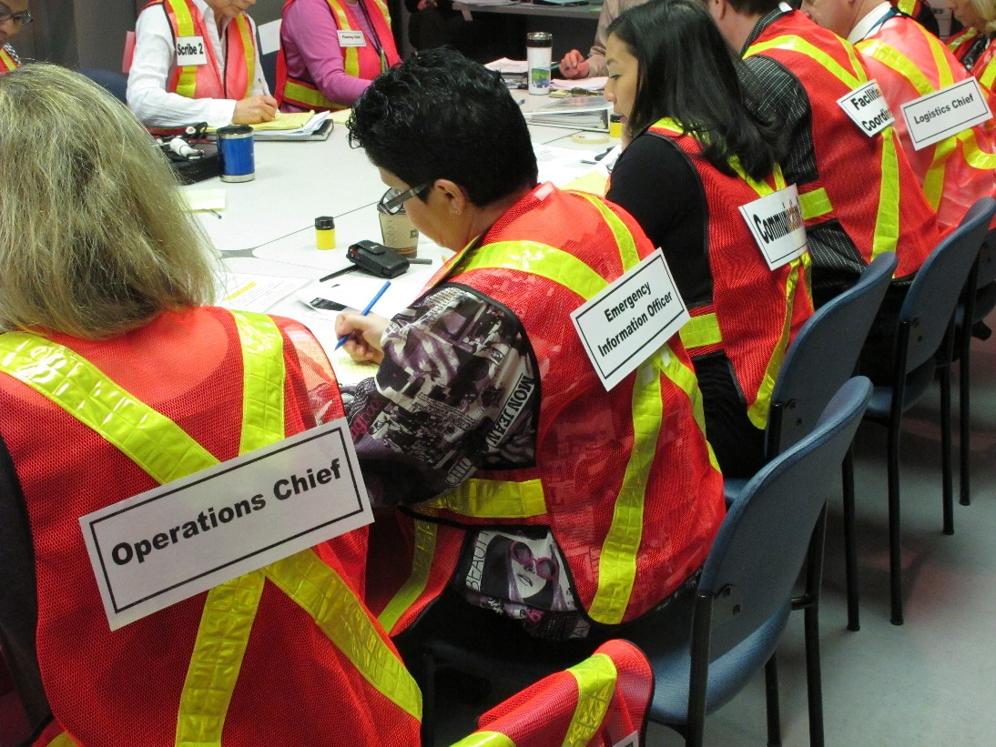
Hospitals Must Conduct Two Exercises per Year
Full-scale, community-based exercise
OR
Functional, facility-based exercise
AND
Full-scale, community-based exercise
OR
Functional, facility-based exercise
OR
Mock disaster drill
OR
Tabletop, seminar or workshop
Notes:
Have they been doing this?

Slide 34

Goal is to have emergency management plans that:
Address all four phases of emergency management
Take an “all hazards” approach and are tailored to conditions of individual workplaces
Are developed collaboratively with key stakeholders and include incident command structure
Are based upon sound data and information
Are practiced on a regular basis
Are living documents that are continually reviewed and updated
Notes:
SM

Slide 35


For ANCC Contact Hour Credit
The code word is SOLIDARITY

Slide 36

Thank you!
For more information, contact us at 4healthandsafety@aft.org

