Slide 1
Hospital Staffing Budget Development
WSNA Executive Director Sally Watkins, PhD, RN

Slide 2

Objectives
We will:
Review how hospitals typically determine budgets for staffing hours
Explore areas of potential concern/need for further clarification
Discuss practical strategies for ensuring Staffing budgets address unit needs

Slide 3
What do you need to know to develop a staffing plan?
Notes:
This portion of presentation is to make sure you understand some key concepts related to staffing and budgeting –

Slide 4

Units Of Service (UOS)
Average Daily Census (ADC) – usually defined by midnight census
Minutes (i.e. OR)
Visits (i.e. ED, Outpatient clinic)
Procedures (i.e. GI lab, cath lab)
Other examples:
  Meals served = dietary
  Work orders - maintenance

Slide 5
Finance typically provides:
Targeted* HUOS for year
X
Anticipated volume for year
= Total number of staffing hours/day
* Clarify what target means, i.e. direct care or total HUOS? includes sitters?

Slide 6
Beginnings of Staffing Plan
Census = 36 HPPD = 8.5 1 RN: 4 Patients
Mix | Chg RN | RN | LPN | CNA | HUC | Total Hours | HPPD
Shift
7 – 3pm 36% | 1 | 9 |  | 3 | 1 | 112
3 – 11p 36% | 1 | 9 |  | 3 | 1 | 112
11 – 7a 28% | 1 | 8 |  | 2 |  | 88 | 8.67

Slide 8
Beginnings of Staffing Plan
Census = 36 HPPD = 8.5 1 RN: 4 Patients
Mix | Chg RN | RN | LPN | CNA | HUC | Total Staff | Total
Shift
7 a.m.– 3 p.m. 36% | 1 | 9 |  | 3 | 1 | 14
3 – 11 p.m. 36% | 1 | 9 |  | 3 | 1 | 14
11 p.m. – 7 a.m. 28% | 1 | 8 |  | 2 |  | 11 | 39 x 1.4 = 54.6

Slide 9
12 Hour Shifts
12 hr shift X 7 days/wk = 84 hrs/wk ÷ 40 hrs = 2.1

Slide 10
The Non-Direct Care hours factor
Unit history:
Paid time – not worked: Paid time – not Direct Care
  Vacation = 4860 hours Education/unit meetings = 3314 hours
  Sick = 4124 hours Residency hours = 4800
  Holidays = 3240 hours
  Jury duty = 80 hours
  Bereavement = 216 hours
TOTAL Hours = 20, 634
Divide by 2080* = 9.92 additional FTEs needed
*2080 = number of total paid hours per 1.0 FTE
Coverage for rest and meal break coverage still needs to be added

Slide 11
Position Control Review/Analysis
Name of Employee: _____________________ Position: _________________(e.g. Staff RN)
FTE: (ex. 0.9) ________ | Seniority Level: (ex. Step 20) PTO hours earned/yr: | Planned PTO: (ex. 4 weeks Europe or pregnant so planning maternity leave) | Avg Short Notice Off hrs/employee (e.g.sick calls):
Required Education* | Hours/year
Skills Day
Online modules
Other CE: (list each)
BLS Recertification
Meetings | Hours/year
Staff meetings
Charge RN meetings
Committees: (list each)
Staffing committee
Shared Governance
TOTAL Hours
Overall Total:

Slide 12


Benchmarking
processes and pressures
Mapping to find “peer groups”
Organization determination of what performance level to achieve i.e. “better than 75% of peers” = 25th percentile goal
National databases
Limitations:
  How know targets are “good”?
  Who is included in the database? Large enough peer groups?
  What characteristics are “mapped”?
  Is quality outcome data included in the mapping?
Notes:
Who knows if their organization is using a benchmarking database? Which one?

Slide 13
Additional “tips and tricks”
Can Residency programs be in a separate cost center?
Truly review in detail “required” education
What is your “churn” factor (ADT)?
How many hours are being spent “off unit” for codes, etc.?
What other data can you collect to help tell the story, e.g. miles walked/shift, missed care, time spent getting supplies, etc.

Slide 14
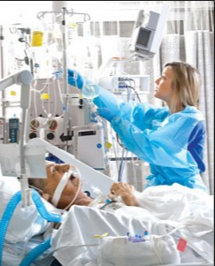
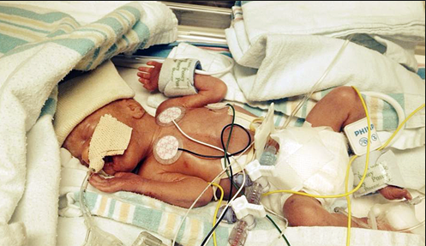
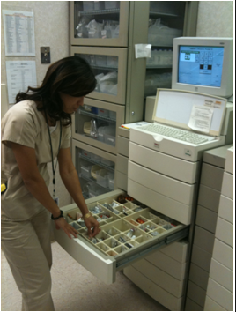
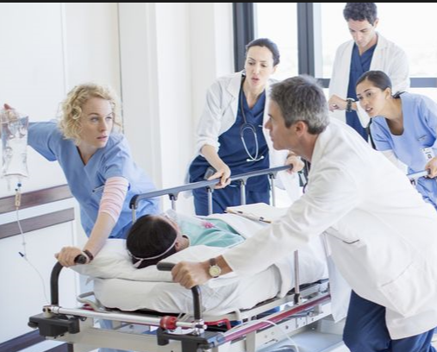
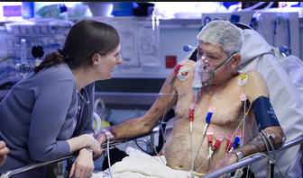
It’s all about our patients!

Slide 15
THANK YOU!

