Slide 1
The Roots of the Opioid Crisis: How Frontline Workers Are Making a Difference
AFT NHP Professional Issues Conference
June 4, 2018
Steve Rooney, RN, AFT VP
Michael Kink, Strong Economy for All/Hedge Clippers
Julie Hutchinson, MPA, MSN, RN
Sara Markle-Elder, AFT NHP

Slide 2
Objectives—To understand:
The scope & severity of the opioid crisis
How it has happened and who is responsible
Addressing how to help the addicted
Policy and bargaining solutions
Notes:
The New York Times wrote recently that this opioid crisis is 150 years in the making. It started then much as this current crisis did, with a new product that was highly profitable for the manufacturers, distributers and the prescribers.
The crisis today is much more widespread and much more deadly.
As healthcare workers, we are on the frontlines, treating pain and treating addicted patients, and perhaps even dealing with our own risk of addiction or that of our loved ones.
Other AFT members also have to confront the opioid crisis. Teachers, school nurses, and other personnel work with children whose parents are addicted. Public employees, such as librarians and caseworkers are administering naloxone. Emergency responders in some locations respond to multiple overdose cases per day and have to worry about being exposed to synthetic opioids accidentally.
So AFT is joining the fight to address the opioid crisis. We are fighting for policy changes that will hold bad actors responsible and provide access to quality treatment. We will be rolling out online training resources soon. We also have to bargain for ourselves and our communities to protect us from risk of addiction and to provide humane treatment for those who do become addicted. Our time here today will be devoted to:
Understanding the problem (Steve)
Understanding its roots and who has benefitted (Michael Kink)
Addressing how to treat addiction and how to use alternatives for pain management (Julie Hutchinson)
Developing bargaining and policy solutions we can use. (Sara Markle)

Slide 3
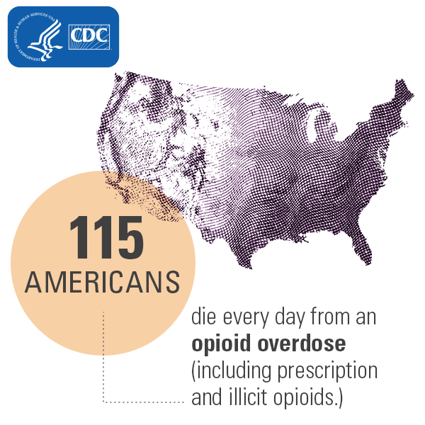
A deadly problem
From 1999-2016, more than 350,000 people died from an opioid-related overdose.
Roughly 42,000 died in 2016 alone.
Opioid overdoses increased 30% from July 2016 to September 2017
in 45 states.
The increase in the
Midwest was 70%.
Notes:
The magnitude of this problem is huge. Opioids have been called a “weapon of mass destruction—manufactured death.”
Philadelphia’s health commissioner Thomas Farley has said, “This is a health crisis that’s worse than we’ve ever seen. This will kill more people than the AIDS epidemic. You have to go back to the influenza pandemic of 1918 if you even wanted to start making comparisons.”
The problems beyond loss of life and misery for the addicted. It includes: huge public outlays for emergency response, children flooding into the foster care system, and a lack of quality treatment options for the addicted.

Slide 4
How did we get here?
Notes:
This current rise in opioid overdose deaths can be outlined in three distinct waves.
The first wave began with increased prescribing of opioids in the 1990s ², with overdose deaths involving prescription opioids (natural and semi-synthetic opioids and methadone) increasing since at least 1999.
As officials cracked down on pill mils, doctor shopping and other ways to access prescription opioids, people with opioid addiction began to turn to heroin. The second wave began in 2010, with rapid increases in overdose deaths involving heroin.
The third wave began in 2013, with significant increases in overdose deaths involving synthetic opioids – particularly those involving illicitly-manufactured fentanyl and other synthetic opioids. The market continues to change, with the addition of other highly addictive, illicitly-made synthetic opioids.

Slide 5
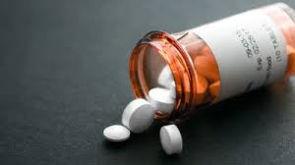
Prescription opioids are highly addictive
21 to 29% of patients prescribed opioids for chronic pain misuse them.
8 to 12% develop an opioid use disorder.
4 to 6% who misuse prescription opioids transition to heroin.
80% of people who use heroin
first misused prescription opioids
Notes:
Many of you will remember when pain became the fifth vital sign in the mid-1990s. This happened shortly after FDA approved OxyContin. This was not a coincidence.
In 1995, the concept of pain as a vital sign was first introduced by the president of the American Pain Society—which received and still receives a great deal of funding from opioid manufacturers.
The Joint Commission and the Veterans Health Administration signed on to the idea, which translated into changes in practice. The opioid manufacturers told doctors and their professional societies that the new opioids were not addictive. Sales reps were instructed to tell doctors that OxyContin was “virtually non-addicting.”
As we now know, this is not true. Patients left the hospital with prescriptions for 90 days of highly addictive drugs, for many, with disastrous results.

Slide 6
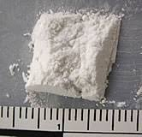
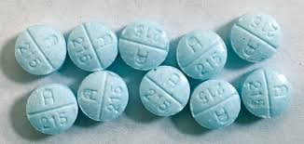
Street drugs are even more deadly
Fentanyl is:
100 times more potent than morphine
50-100 times more potent than heroin
Often mixed with heroin or cocaine
Notes:
While people addicted to prescription painkillers sometimes overdose, the risk is even higher with illicitly-made drugs.
Drug dealers began adding cheaper, more potent illicitly-made fentanyl to heroin. And unlike drug manufacturers, drug dealers don’t maintain quality standards in their basement labs, so the potency of street drugs varies widely.
Fentanyl is used legally to treat patients with terminal conditions. It has many analogs.

Slide 7
Carfentanil: 10,000 times more potent than morphine—100 times more potent than fentanyl
Notes:
This provides an illustration of the potency of fentanyl and carfentanil and gives us an idea why so many people are overdosing. This also illustrates the risk to healthcare workers who may inadvertently come in contact with these drugs.
Carfentanil is a veterinary drug used on large mammals-literally elephant tranquilizer.
Fentanyl claimed the lives of 75 Ohioans in 2012, but by 2015 that number jumped to a staggering 1,155.
Fentanyl was found in 56 percent of all drug overdoses in British Columbia—up from 31 percent in 2015. The province's 300-plus fentanyl deaths this year has been declared a public health emergency.
Why is Fentanyl used? it's cheap and available, and it's easy to synthesize in laboratories. Many of the precursor chemicals are imported from China.

Slide 8
Opioids Change the Brain
Notes:
It’s important that we all understand that addiction is a physiological problem. It is not a matter of willpower or strength. We won’t be able to address this problem if the stigma of drug addiction continues to prevent people from seeking treatment.
While some people have families histories of addiction or other reasons they are more susceptible, anyone can become addicted to opioids and many people have become physically dependent on opioids simply by following their doctor’s orders.
Opioids overstimulate the brain’s reward pathway, a massive release of dopamine, causing dysregulation. (in the nucleus accumbens—underneath the cerebral cortex)
The brain remembers that feeling, and the memory is stored in the limbic system (hippocampus and amygdala) —resulting in powerful memories that last a lifetime. This is why it is so common for people in recovery to relapse.
But the brain also seeks to regulate itself. It produces less dopamine or eliminates dopamine receptors, resulting in tolerance. It takes more and more of the drug to create that same release of dopamine. Eventually people need the drug just to feel normal, not to feel pleasure.

Slide 9
What is Addiction? The three Cs: loss of Control, Craving, continued use despite adverse Consequences
“Addiction” did not appear in the Diagnostic Manual of the American Psychiatric Association until the latest volume, DSM-V, and remains difficult to define.
Do you continue to use despite the fact that there are adverse consequences?
Do you crave?
Do you want the activity that you're engaged in more and more over time?
Do you have a sense of control loss?
Do you think that you've lost control over the activities in your life?

Slide 10
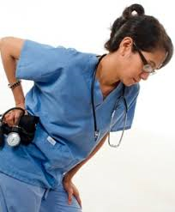
We are at risk ourselves
In 2015, there were 5,515,593
occupational injuries that required
time away from work.
1,764,990 of those workers were prescribed opioids for their occupational injuries.
Healthcare workers are at high risk of injury due to patient lifting injuries, workplace violence, and slips, trips, and falls.
Notes:
The risk of addiction is high for healthcare workers, who still have some of the highest injury rates in the country for ergonomic injuries and injuries from assault.
Higher overdose rates have been found in people in occupations with high injury rates. One Utah study found that 57% of people who died of an overdose were addicted due to work injuries.
The problems we face in healthcare exacerbate this problem. Low staffing causes injured staff to feel pressure to return to work before they are healed. They rely on painkillers to return to work.
Our broken workers’ comp system also contributes to the risk of addiction, when people wait months for procedures or rehab.
And nurses work in fear of losing their license. Most states have alternative to discipline programs that allow nurses with addictions to maintain their license through a structured recovery process, but some may feel compelled to hide their problem.

Slide 11
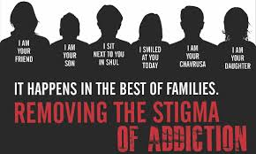
Removing the stigma of addiction
Notes:
As health professionals, we can be part of a new narrative about addressing addiction as a disease “Substance use disorder (SUD), or opioid use disorder (OUD)” and not as moral failing.
Some have rightfully pointed out that during the crack epidemic in the 1980s and other times drug epidemics threatened the African American community, there was no national outcry like we are seeing now. Instead of talking about reducing stigma and providing quality treatment options, the national narrative was about condemning addicted people and jailing them for possession of small amounts of drugs.
This is true. We have to acknowledge that. But the size of this crisis makes it imperative that we address the problem. Solutions need to be found to prevent more people from becoming addicted and to help the people who are addicted.

Slide 12
Together, we will face this challenge as a national family with conviction, with unity, and with a commitment to love and support our neighbors in times of dire need. Working together, we will defeat this opioid epidemic.
President Donald J. Trump
Together, we will face this challenge as a national family with conviction, with unity, and with a commitment to love and support our neighbors in times of dire need. Working together, we will defeat this opioid epidemic.
President Donald J. Trump
March 1, 2018
Notes:
October 2017 President Trump Calls the Opioid Crisis a Public Health Emergency
Dec 2017 Kellyanne Conway appointed to head an “Opioid Cabinet”, The Office of National Drug Control Policy (ONDCP) is excluded
March 1, 2018 White House Summit on Opioid Epidemic calls for more Law enforcement and interdiction, prevention and education through a sizable advertising campaign, improving the ability to fund treatment through the federal government
March 18, 2018, in a speech in New Hampshire, the president called for increasing arrests by ICE, building the Wall, and the “ultimate punishment” for dealers.
We’ll see what happens
https://www.crisisnextdoor.gov/
https://www.whitehouse.gov/briefings-statements/president-donald-j-trump-combatting-opioid-crisis/help those impacted by the epidemic find jobs while fighting addiction,

Slide 13
What are the issues that face us as healthcare providers and union members? What do we want to take on?
Notes:
Ask the participants to volunteer some issues. I can assist with writing down what they bring up. If they don’t bring things up, here are some things you can mention.
Changing healthcare practice
alternatives to pain management—pain management guidelines
Standards for treatment
Insurance coverage for treatment
Public funding for treatment
Protections for injured healthcare workers—return to work policies—alternatives to discipline
Risk of accidental exposure

