Slide 1
Effective Communication for Healthcare Professionals
AFT National
A job for every Member
Union Leadership Institute

Slide 3
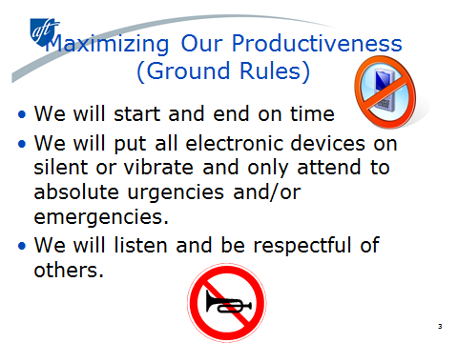
Maximizing Our Productiveness
(Ground Rules)
We will start and end on time
We will put all electronic devices on silent or vibrate and only attend to absolute urgencies and/or emergencies.
We will listen and be respectful of others

Slide 4

Question?
Table Talk
What characteristics do Effective Communicators have?

Slide 5

Listening is the first step!

Slide 6
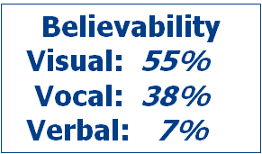
Elements of Effective Presentation
The spoken word (multi-channeled) is almost the polar opposite of the written word
In the spoken medium, you must be believed to have impact. No message no matter how eloquent, brilliantly delivered or painstakingly documented is able to penetrate a wall of distrust, apprehension or indifference
Believability is overwhelmingly determined at a preconscious (emotional)

Slide 7
Elements of Effective Presentation
A person making a speech/presentation must establish emotional trust before any effective verbal communication can take place.

Slide 8

Eye, Energy, & Natural Self
Eye communication
Posture and movement
Dress and appearance
Gesture and smile
Voice and vocal variety
Words and non-words
Listener involvement
Humor
Natural Self

Slide 9
Eye Factor

Slide 10
Eye Factor:
Eye Communication
Establishes 1:1 communication
Appear confidant
Build audience involvement
5 second rule
Beware of the “eye dart”
Beware of the “slow blink”

Slide 11
Eye Factor:
Posture and Movement
Stand tall
Avoid rocking or leaning
Get in “ready” position
Move, engage with the audience

Slide 12
Eye Factor:
Dress and Appearance
Be appropriate
When in doubt, dress up

Slide 13
Eye Factor:
Gestures and Smile
Get rid of your nervous gesture
Exaggerated gestures are A-OK
Give a genuine smile at the beginning and ending

Slide 14
Energy Factor

Slide 15
Energy Factor:
Voice and Vitality
Avoid monotone by varying volume
Put real feelings into your voice

Slide 16
Energy Factor:
Words and Non-Words
Build your vocabulary
Paint word pictures that help visualize things
Beware of jargon
Get rid of non-words (um, ah, okay, like, well, I mean…)
Replace non-words with a simple pause

Slide 17
Energy Factor:
Listener Involvement
Eye contact
Moving to different parts of the room
Pointing
Use questions, even rhetorical ones
Using demonstrations, samples and gimmicks
Create interest through your own involvement in the speech

Slide 18
Energy Factor:
Humor
Stay away from jokes—they rarely work
Focus on being FUN over FUNNY
Use humor in language or in experiences

Slide 19
Energy Factor:
Humor
Stay away from jokes—they rarely work
Focus on being FUN over FUNNY
Use humor in language or in experiences

Slide 20
Develop Your “Natural Self”
Think “emotional trust”
Know your strengths and weaknesses
Focus on one skill at a time
Speak at every opportunity
Get feedback
Use videotape
Take risks
20

Slide 21

Impromptu
Chose from given scenarios

Slide 22

How do I connect?

Slide 23

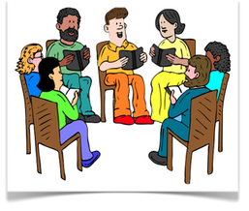
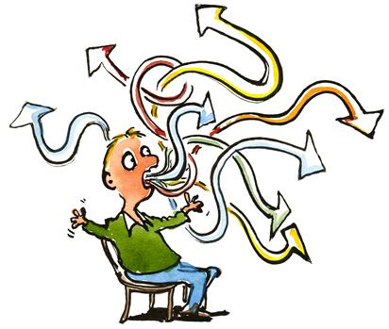

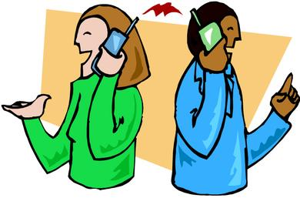
Verbal Communication

Slide 24



How do I say it?

Slide 25
Methods of Delivery
“the good & the bad”
Extemporaneous – speech is delivered from a clear outline that is carefully planned and practiced
Memorized – Every word is committed to and delivered from memory
Manuscript – Speaker reads the speech
Impromptu – Speech given without advance notice or specific preparation

Slide 26
Preparation
Consideration of the occasion and the audience will help in the preparation and help clarify the general and specific purposes.
Audience
Needs
Attitudes
Experience
Age range
Education
Occasion
Celebration
Political meeting
Rally
Dinner
Membership meeting
26

Slide 27
Elements of Content
General Purpose
  To inform
  To persuade
  To entertain
Specific Purpose
  Contain one central idea or theme
  Objective should be clear and concise
  Purpose should indicate the desired response--what the audience is to know, feel, believe or do

Slide 28

What do I SAY?
You can’t walk the talk if you have no talk
You can’t practice what you preach if you have no sermon
You must find Your VOICE
You have to clarify your values and beliefs. You have to be clear about the principles that guide you in your work and in your personal life. Then you can choose words and actions that are consistent with those principles.

Slide 29
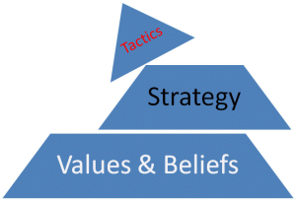
Values
the accepted principles or standards of a person or a group
Notes:
Ask them to take out handout..Defining your values

Slide 30
Shared Values
Foster feelings of personal effectiveness.
Promote company loyalty.
Facilitate consensus about goals and stakeholders.
Encourage ethical behavior.
Promote strong norms about working hard and caring.
Reduce job stress and tension.
Foster pride in the company.
Facilitate understanding about job expectations.
Foster teamwork and esprit de corps.

Slide 31
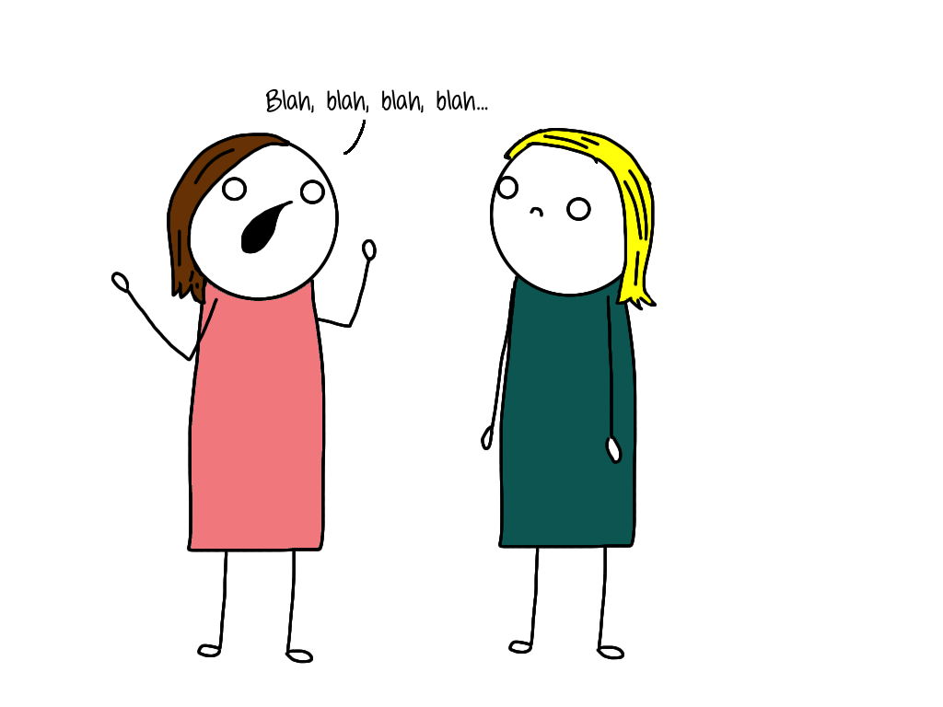
Telling your story
Notes:
Each participant meets 3 others they don’t know or have little contact with and introduce themselves and tell why they are active in the union.
Chart key words from the report out.. “voice..power… money.. Safety..etc

Slide 32

What experiences and values have led you to this point?

Slide 33
Visuals can benefit the audience by:
Highlighting important points
Clarifying and helping with understanding
Providing an additional access point to information particularly for visual learners

Slide 34
Visuals can benefit the presenter by:
Not having to rely solely on notes
Keeping you focused and efficient
Giving an overview or details
Engaging visual learners

Slide 35
Handouts, Flyers, Leaflets
A single piece of paper can be a critical element in being able to communicate.
  Handouts
    Write from the intended audience point of view
    Avoid jargon or excessive details
    Use a central theme
    Use cartoons, pictures, charts etc…
    Make sure it is clear and relates your message
    Ask for a union bug!
Notes:
Go over hand out with them.

Slide 36
