Slide 1
The Oregon Nurse Staffing Law Past to present
Jordan Ferris, BSN, RN, CMSRN
Nursing Practice Consultant, Oregon Nurses Association

Slide 2
Brief History
Law originally passed in 2001
Updated in 2005
Most recently updated in 2015 – SB 469
Biggest changes in 2015
Stricter MOT language
Staffing committee changes
Staffing Plan language and review req’s
NSAB
Enforcement
Notes:
Oregon passed its law through the state house and senate. Bi partisan. Legislators that were friendly towards ONA introduced the bill and sponsored it – had over 10 sponsors Dem and Rep. Culmination of lots of background work.
Originally met with OAHHS to collaborate on staffing law changes. Passage of 469 was collaboration between hospitals and the nurses. Originally started with strict ratios, but that got taken out in favor of “acuity based staffing”

Slide 3
MOT language
Under SB 469/Nurse Staffing Law, MOT is illegal
Law put limits on workhours that a hospital can REQUIRE a CNA/LPN/RN to work
No more than 12 hours in 24 hour period
No more than 48 hours in hospital defined work week
Not in the 10 hours following the 12th hour worked
Beyond the agreed upon and prearranged shift
Hospital must have MOT policy and document all MOT
Does not change ability for nurse to volunteer

Slide 4
Staffing Committee changes
Requires staffing committee to have 1 non-RN sit on the committee
Meetings must be AT LEAST quarterly
50% management and 50% direct care staff
Must release NSM from assignment to attend
Collective bargaining language
Notes:
CBA language has allowed us to stage multiple coups within hospitals with nurses overthrowing committees made by management, leveraging power, using agency

Slide 5
Staffing Plans and Reviews
Staffing plans much more detailed under new law
Reviews also more detailed
Law explicitly states what must be covered in plans/reviews

Slide 6
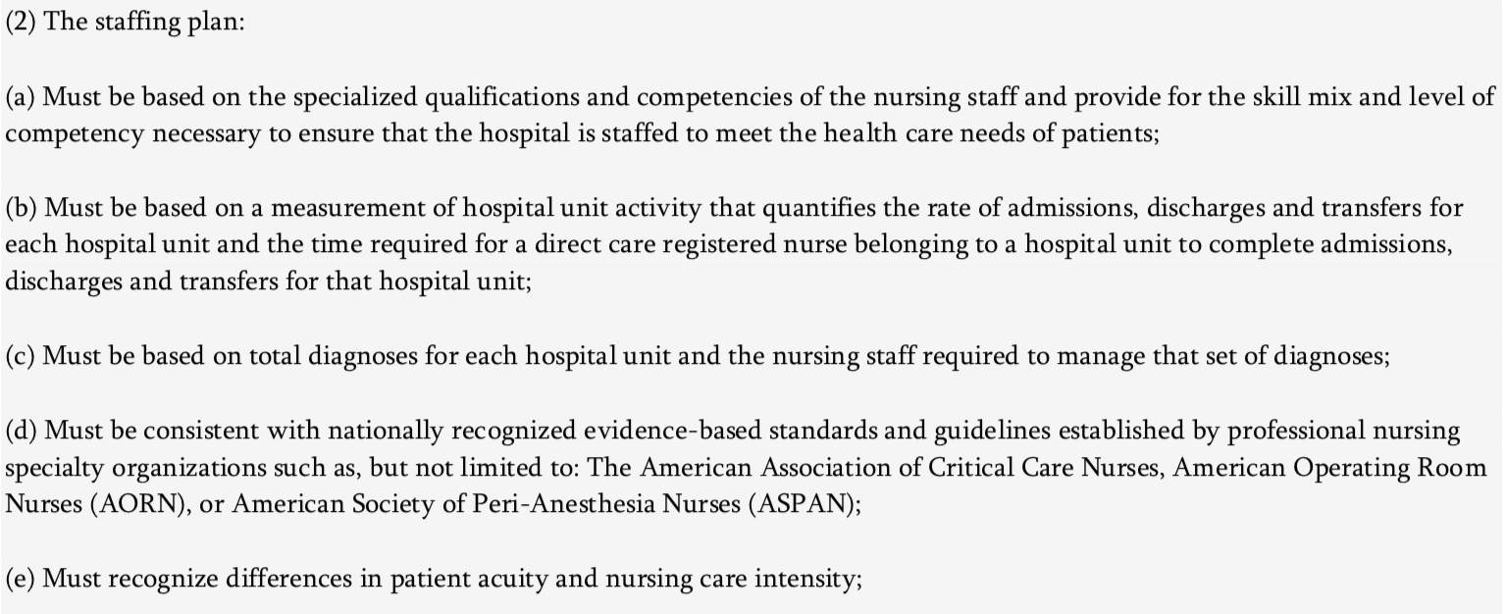
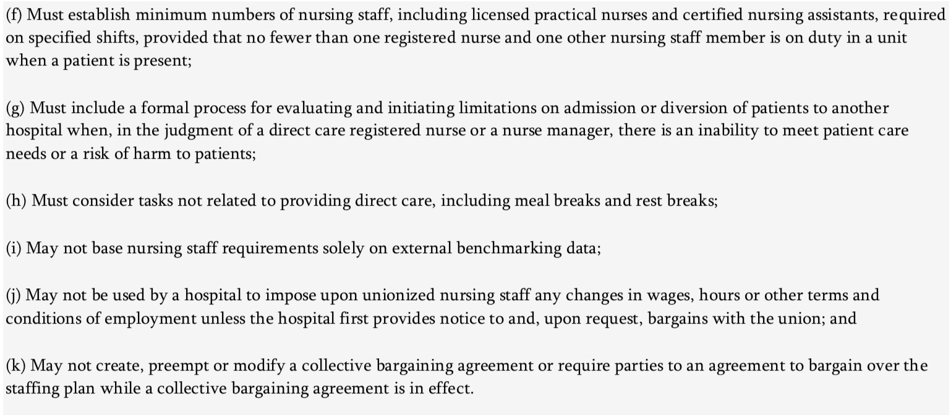
Notes:
How do we deal with specialities

Slide 7
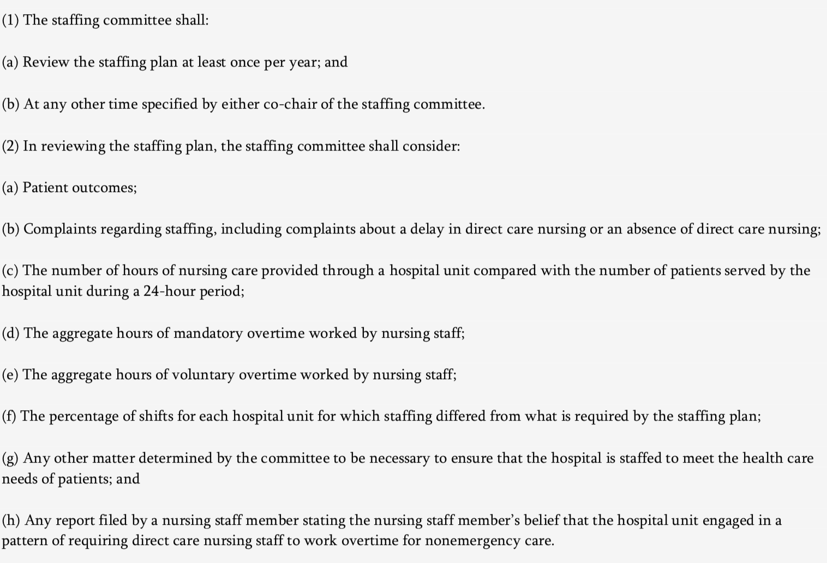

Slide 8
Nurse Staffing Advisory Board
State level mega-staffing committee
Same composition as hospital based committee
Draws from multiple specialties/hosp. sizes
Waivers and other concerns get elevated to NSAB
Notes:
12 members, governor appointments
Advice to OHA
Identify trends, concerns, opportunities
Reviews OHAs enforcement powers and processes
Currently reviewing Survey Monkey OHA uses in investigation process

Slide 9
Enforcement
One of the biggest changes
Oregon Health Authority (OHA) now has specific language/timelines
Complaint → Survey → Statement of Deficiencies → Plan of Correction → Approval → Resurvey
Notes:
Audit once every 3 years
Initiate investigations within 60 days of complaint
Resurvey within 60 days of approved plan of correction
All findings are made public

Slide 10
What is working?
Nurses feeling much more empowered to take control of staffing committees
Staffing committees now one of the most powerful tools we have
Complaint process and surveys and changing landscape of nursing in Oregon
Giving nurses agency over their working conditions beyond CBA
More information exchange
Notes:
Bend meals and breaks
Acuity
Dedicated relief nurses
FTE changes

Slide 11
What needs to be adjusted?
Still ambiguity in the bill
OHA not holding up their end of bargain
Actual survey getting bogged down in “process and documentation”
Only one approved plan of correction out of 30
Resurveys can’t happen until approved PoC, so many staffing issues continue
Meal and breaks, buddy system
Notes:
Acuity ambiguity – must be taken into consideration
Survey times, now 60 business days and now there is an undetermined “triage and info finding” period
Back to waiting for 1 year for survey and results
Renaming the buddy system, some CNOs challenging the OHA on findings, OHA unhelpful

Slide 12
Next steps
Need to tighten up language
Streamline survey process
Clarify OHAs role and responsibilities
Continued nurse engagement/empowerment
Data collection
Organizing model
Collaboration with OAHHS

