Slide 1
The FMCS and you!
Robin Haux, Montana nurses association
robin@mtnurses.org * 406.431.5934

Slide 2
History of the Federal Mediation and conciliation Service (FMCS)
The Federal Mediation and Conciliation Service (FMCS), and independent agency within the federal government was established by the Labor Management Relations Act of 1947.
The FMCS was created to resolve collective bargaining disputes AND to promote the development of sound and stable labor-management relations
Through practice and legislation, this mission has evolved to include “fostering the establishment and maintenance of constructive joint processes to improve labor-management relationships, employment security and organizational effectiveness”
Notes:
The FMCS was created to assist with labor peace. Labor disputes do not just effect the Employees and Employers…..they affect communities…..and disputes can lead to long lasting effects… LMC is a TOOL to assist with labor relations.
*A worst case scerenio the FMCS was designed to assist with resolution is a labor strike. A strike leads to a work stoppage for both the employees…..and therefore affecting the employer. In healthcare, by law you have to give 30 days notice of a stike for a 24hr facility. But think how that will affect the community and patient care. The FMCS was created to assist with reaching resolutions before a strike.
What does the FMCS do besides LM?? Mediation, maintain arbitrators lists. (explain mediation and how we use it…..explain third party arb….how we use it. FMCS training and mediations is FREE of charge!

Slide 3
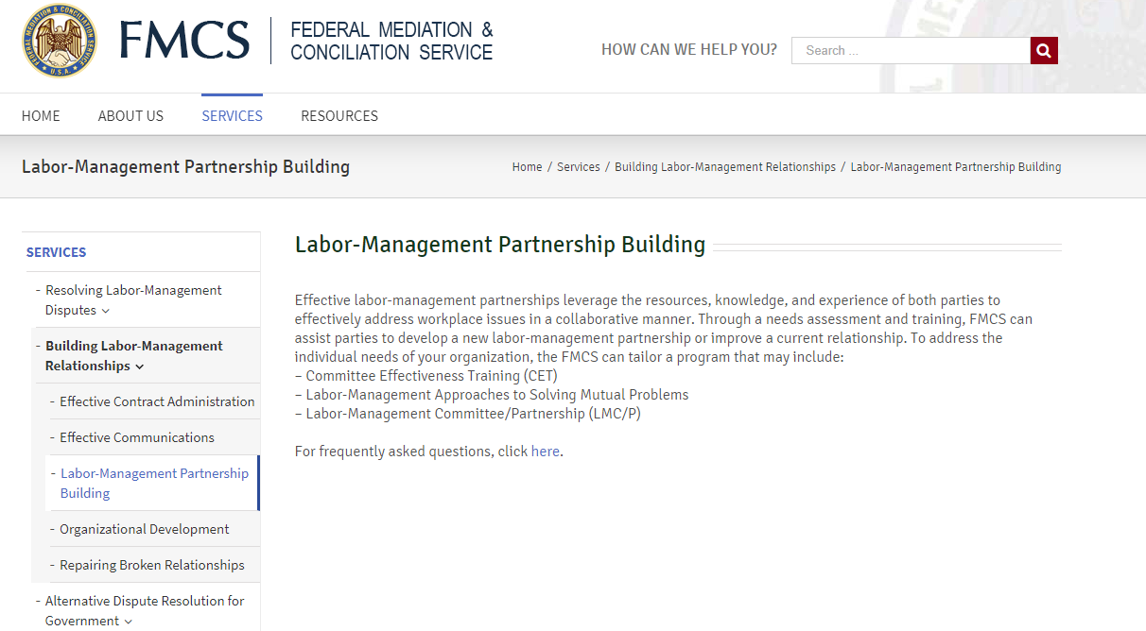
Notes:
FMCS is always willing to train on effective communication; LMC committees.
Questions – have any of you participated in IBB?? Have you participated in the FMCS IBB training?? Really good team building…communication building tools
Thoughts – this is why it is a good thing to get a commitment from your members to be on committee for a deifned period of time……realtionships happen…sometimes even if mgmt. doesn’t want them too!

Slide 4
In the LMC training, the parties learn…
Establish and maintain LMC Committees by bringing representatives together to communicate over subjects of mutual interest.
Begin building the foundation for an working organization committed to cooperative efforts through an ongoing forum to deal with common problems
Consensus – building and problem solving processes to collaborate on issues in the work place.
Finally, they create a LMC Charter
Notes:
The training has the parties working together and at the end, they create a Charter….a written agreement defining the processes to which the committee members agree to.

Slide 5
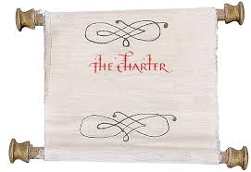
What is the LMC Charter?
A LMC Charter contains (through mutual agreement)
Mission Statement
Goals and Objectives
Defined membership
Meeting chairs
Decision making process (consensus, etc)
Sphere of Influence (level of authority: 1-full, 2- recommended, 3-no authority**
Behavior Norms
Guests/Observers
Meeting frequency and Agenda process
Etc…
Notes:
Through mutual agreement, a charter can contain any item that follows the LMC principals.
Explain shere of influence and give an example…

Slide 6
What is the #1 issue for LMC or PCC (Professional Conference Committees)*
FOLLOW UP
Notes:
For adding languge into your CBA’s…get creative with the names! Some other names are Professional Nursing Committee, Nursing Care Committees…..this can help with mgmt.
Follow up….important from BOTH parties!!! Clearly define in these meetins who is doing what..
EG – CHA holiday schedule! Barg name change…DON hated it….but after 6th meeting….had a question. Led to RN devel new holiday…trial period…ect.

Slide 7
How is LMC working in Montana?
Notes:
Workplace violence reporting….

Slide 8
MNA Facilities covered by a CBA:
Notes:
Talk about how many of these facilities USA LMC regularly or are working at establishing; in a charter make it OK for electronic participation!!!!!! USE technology…..can help with participation.
I wanted to share a few success stories….
Butte – being kicked out!
Another Western MT – another OR department innovative

Slide 9
Why is increasing RN input in the workplace so important?
22 states and Washington, DC have more that
ONE nurse for every 100 people!
and
Nurses are the MOST trusted profession!
American Nurses Association, Fast Facts, The nursing Workforce 2014: Growth, Salaries, Education, Demographics, and Trends
Notes:
According to ANA in 2014……
YOUR VOICE really matters…….when nurses speak, people listen!!!!!!!!
USE your voice

Slide 10
Do you think LMC committees could improve communication in your workplace?
Something to think about?
Notes:
CHANGE IS SLOW at times! I am a firm believer in the fact it can improve communication. It helps by creating an equal playing field for communication…..meaning everyone thoughts matter. It can take time to build that mutual trust and all participants need to really be committed.

Slide 11
What are some topics you believe could be improved if you were to participate on a LMC Committee?
Notes:
A few other success stories in MT:
At a central MT facility, STD/LTD and
job share with Denver facility in the trauma center.

Slide 12
Questions??

