Slide 1

Building Political Power
Political Boot Camp
May 1, 2018

Slide 2
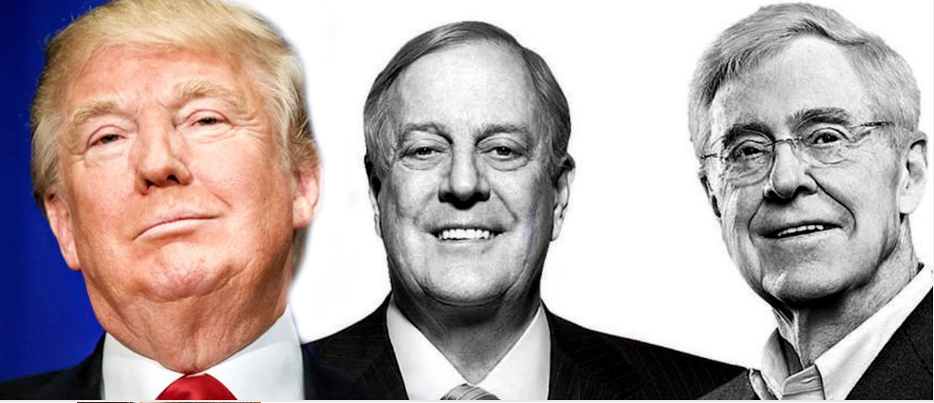

Slide 3
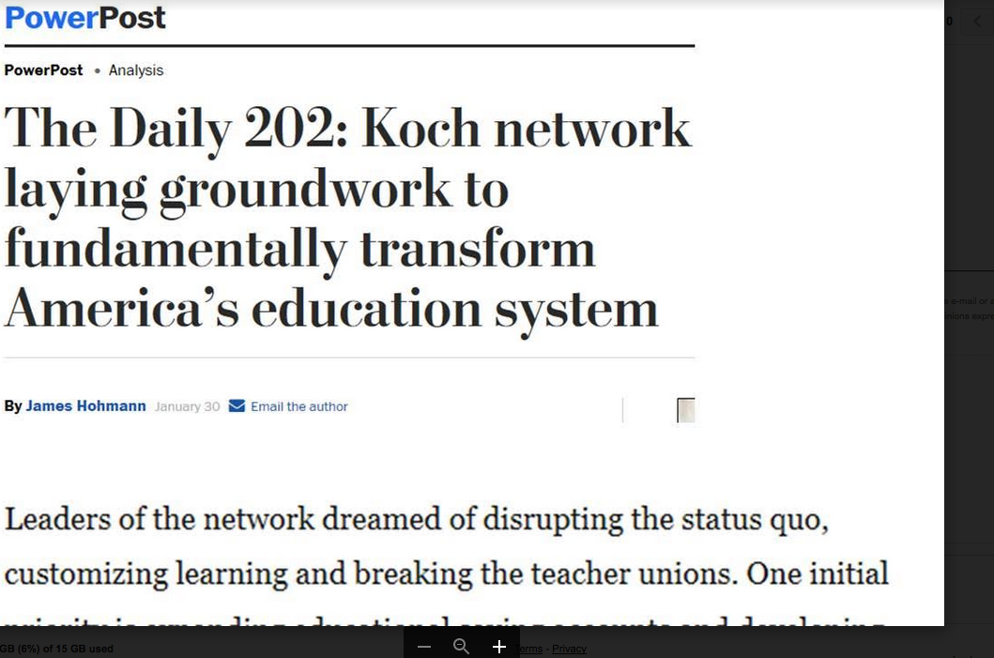
The Koch brothers will spend
$400 Million this Election Cycle

Slide 4







Who’s Behind the Attacks
Individuals
“In the states of Washington and Oregon, a group called the Freedom Foundation was awarded $1.5 million over three years to "educate union workers themselves about their rights — which, if and when exercised, would defund Big Labor." [Milwaukee Journal- Sentinel, 5/5/17]
Koch Brothers
Grover Norquist,
Brent Yessin
David Humphreys
Americans for Prosperity
36 chapters with 2.8 million activists and 650 paid staff pushing the agenda via field, mail, events and paid media – and lobbying.
Big Foundations
$200M Increase from Bradley
Funds Advocacy and SPNs
50M Arnold Foundation on attacking pensions
ALEC
Their goal: Kill labor with a “death by a thousand cuts”¹
Local RTW ordinance
Comprehensive Public Employee Freedom Act
Pre-emption bills
“Advocacy Organizations”
Center for Union Facts
National RTW Committee – 2.8 million members
Center for Worker Freedom – Intervened in UAW TN vote
State Policy Network
$8M anti-union campaign
“Cost Unions Tens of Millions of Dollars”
Toolkit to “Curb Union Influence”
Echo Chamber
Franklin Center
Investment in digital and alt-right media
¹Brent Yessin, ALEC mtg 12/2015

Slide 5
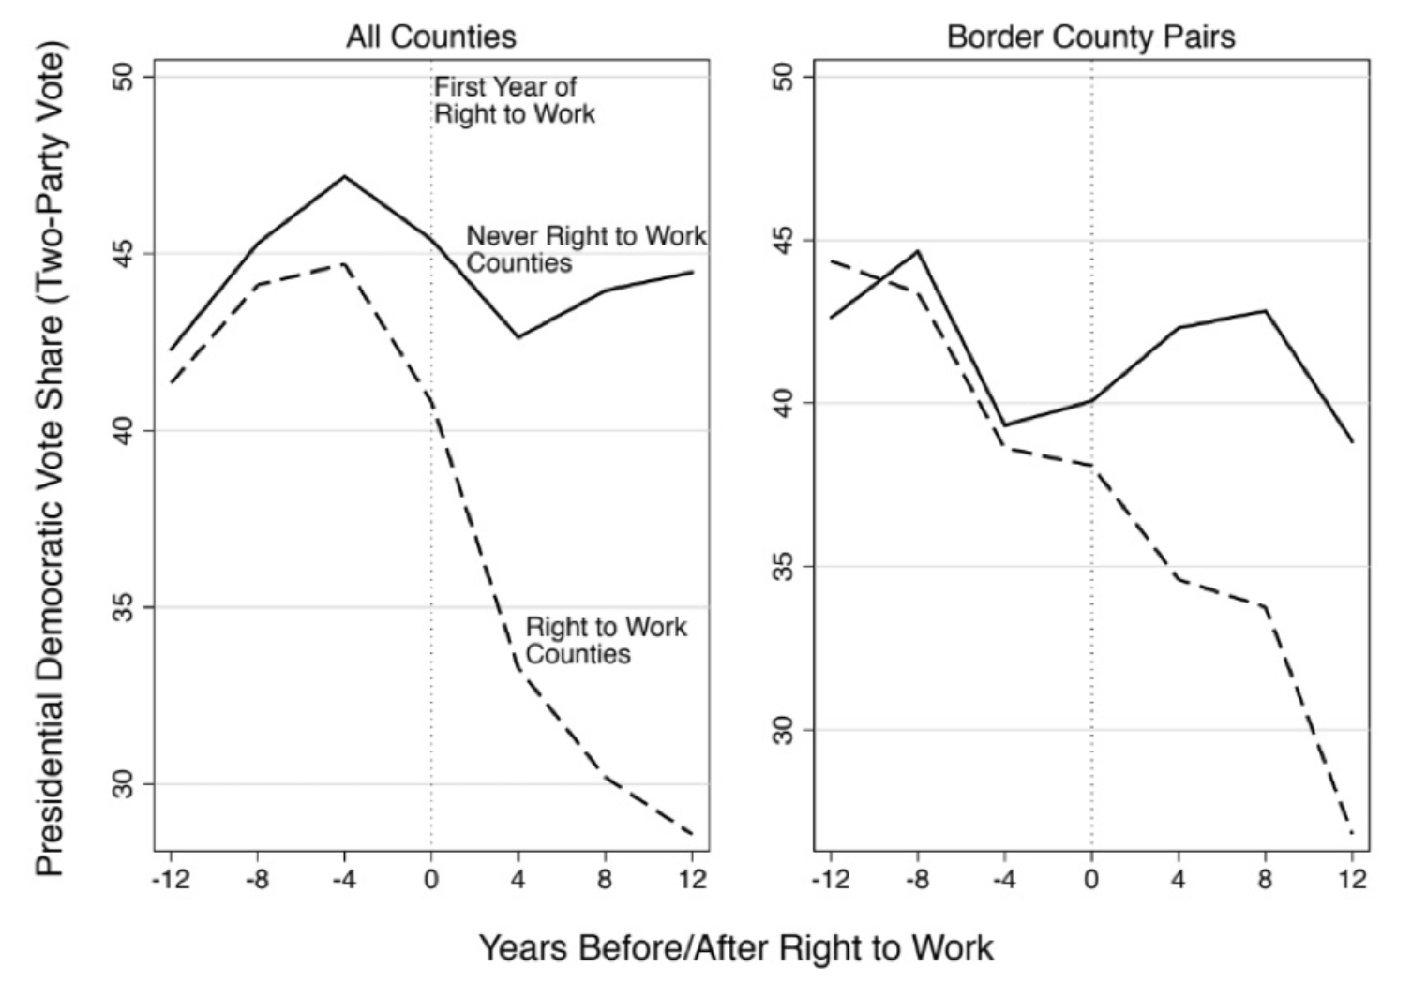
Right to Work for Less Laws Depress Democratic Vote by 3.5 %
National Bureau of Economic Research Reported in The Nation
https://www.thenation.com/article/right-to-work-laws-are-killing-democrats-at-the-ballot-box/

Slide 6
As AFT, a stalwart advocate for progressive ideals, we must fight:
To create great neighborhood public schools for every student, in every neighborhood and for high-quality affordable public higher education;
For economic opportunity for every American and the opportunity to advance by joining a union;
For affordable, high-quality healthcare for every American;
To uphold and defend democracy, pluralism and voting rights; and
Against discrimination, hatred and bigotry, so we can create a more fair and just society for all.
Notes:
We are not content to just stop the Trump Agenda; we are intent on going on the offense for our vision of America.

Slide 7
Building Long Term Power
We must find a ways to rebuild trust, build power for working people, and win elections in 2017, 2018, and 2020 and beyond.
We need to build campaigns from the ground up. This includes bringing as many stakeholders together as possible, as early as possible, to determine strategy and tactics.
Our plan to win is predicated upon empowering locals and states to collectively move a national campaign that connects issues and fights on the ground that are already underway.

Slide 8
How We Win
We Care
  Work on issues member care about
  Hurricane Relief, Wild Fires, and school shootings
We Fight
  At the job
  At the capitol and in their communities
We Show Up
  Actions
  Election day
  Building Trust and Connections

Slide 9
Building Power For Our Members
Our Values / Voice
Our Issues
Our Candidates
Our Campaigns
Our Victory
Our Legislative Agenda

Slide 10
What’s at stake in 2018?
Governors
Going into 2017, Republicans control 33 governorships—the highest number since 1928
90% AFT members in states with gubernatorial elections.
    50%+ in Republican states with open or vulnerable seat.
U.S Senate
Need a net gain of 2 senate seats to take control of U.S. Senate
U.S. House
Democrats need to gain 24 U.S. House Seats to reclaim the House majority
23 Republicans in Districts won by HRC
Repubs have 40 seats as toss-up/lean; D’s only 9
State Legislative Chambers
State Legislative races building to 2020

Slide 11
2018 Political Program
Post –Janus: Comprehensive Power Building
  Organizing, Member Engagement and Political
Issues First
  Student Debt
  Walkouts
  Tax Reform
  Gun Control
Candidates on our terms
Social Media

Slide 12
Election 2018: The Mission
Restore Power to the Working People of America
Put a Check on the Policies of Donald Trump and Betsy Devos
      Take Control of At Least one Chamber of Congress
Win Governors & State Legislatures – Break Trifectas

Slide 13
2018 Election Discussion
The Environment
The Issues
The Elections

Slide 14

DONALD TRUMP APPROVAL RATINGS
Tax reform gave President Trump’s approval a bump, but it has since plateaued and remains negative overall
Donald Trump approval ratings since inauguration
HUFFPOST POLLSTER AGGREGATE
Average
March 29
■ Approve ■ Disapprove
53.0%
41.5%
Source: HuffPost Pollster, “Poll Chart: Donald Trump Approval Rating,” 2018.
March 30, 2018 | Owen Minott, Justin C. Brown & Daniel Stublen

Slide 15
DONALD TRUMP APPROVAL RATINGS
President has maintained his favorability among Republicans, although he has dropped 8% among independents
Donald Trump approval ratings since inauguration
GALLUP
■ Republican ■ Democrat ■ Independent
Average
Jan 29
Average
March 25
89%
85%
42%
34%
13%
7%
Source: Gallup, 2017.
March 30, 2017 | Daniel Stublen

Slide 16
PARTY IDENTIFICATION
Democrats’ have a slight lead in party affiliations, while more of people identify as independents
Party identification
GALLUP
■ Republican ■ Democrat ■ Independent
Average
Jan 4
Average
Dec 11
44%
46%
28%
27%
25%
25%
Source: Gallup, 2017.
January 9, 2018 | Daniel Stublen

Slide 17

2018 MIDTERM ELECTIONS
Presidents with a sub-50% approval rating lose an average of 40 seats in the midterms
Presidential job approval vs. midterm results since 1966
Trump Job Approval
42.8%
RCP Average: Apr 12, 2018
Job Approval
Over 60%
50%-60%
Under 50%
Average Change
+3 Seats
-12 Seats
-40 Seats
November 9, 2017 | Adriana Morton, Madelaine Pisani

Slide 18
HISTORICAL MIDTERM ELECTIONS
The president’s party has lost an average of 25 seats in midterm elections since World War II
President’s party gain/loss of seats in House
VITAL STATISTICS ON CONGRESS
■ Democrats ■ Republicans
2010: Democrats lose control of the House after passing the ACA
1994: Democrats lose their House majority due to health reform plans and Gingrich’s “Contract with America”
Sources: UC Santa Barbara, “The American Presidency Project”
April 23, 2018 | Daniel Stublen

Slide 19
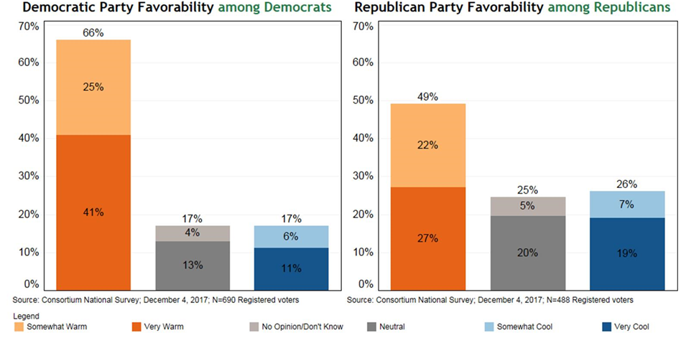
Democratic Base More Positive Towards
Than GOP Base Is Towards Their Party
+49%
+23%

Slide 20
Voters supporting
Democrats and worker issues
Average 12 points better than PVI
PA-18 Conor Lamb
Virginia (Gov +15 Seats)
Alabama Senate
39 State Legislative seats have flipped
Douglas County School Board

Slide 21
Key Takeaways from Alabama,
Virginia and Special Elections
Providing viable candidates – issues matters
African American Voters – amazing
  African American Women
Millennial voters – energized
White educated suburban voters
  especially women (note theme)
Anti-Trump is “naturally” occurring
Democrats must run on positive message
  Attack Trump on policy, not side-show
  Trump gets credit for shaking things up

Slide 22
2018 Election Discussion
The Environment
The Issues
The Elections

Slide 23
OTHER ISSUES
The issues voters care most about in 2018
Which two issues are the most important to you in the 2018 midterm elections?
YOUGOV, MARCH 26, 2018
Percent of respondents selecting each issue*
*Because each respondent chose two issues, the values add up to over 100%
Source: Huffington Post, March 2018.

Slide 24
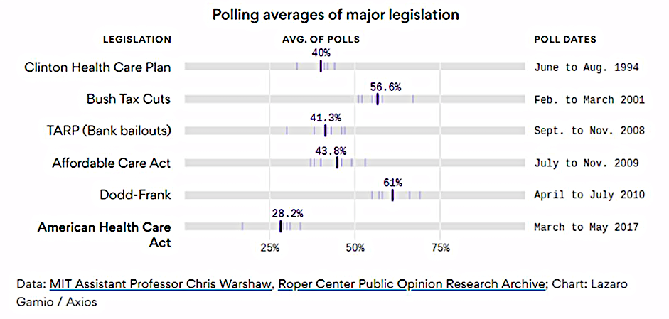
ACHA had the lowest Support Any Major Legislation in the 20 years

Slide 25
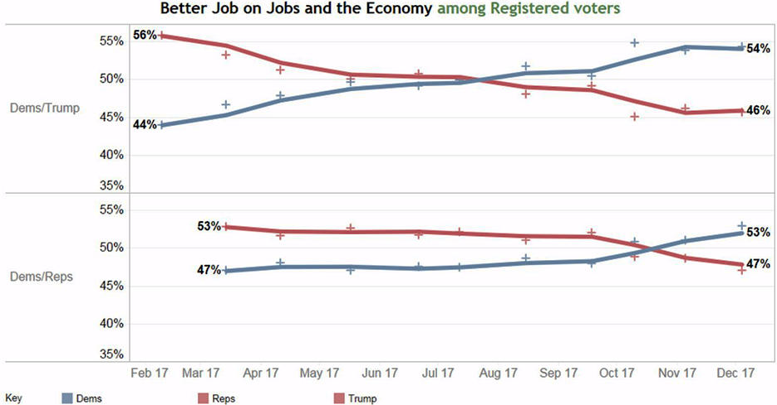
Democrats Are Now Trusted More Than Trump and Republicans on the Economy and Jobs

Slide 26
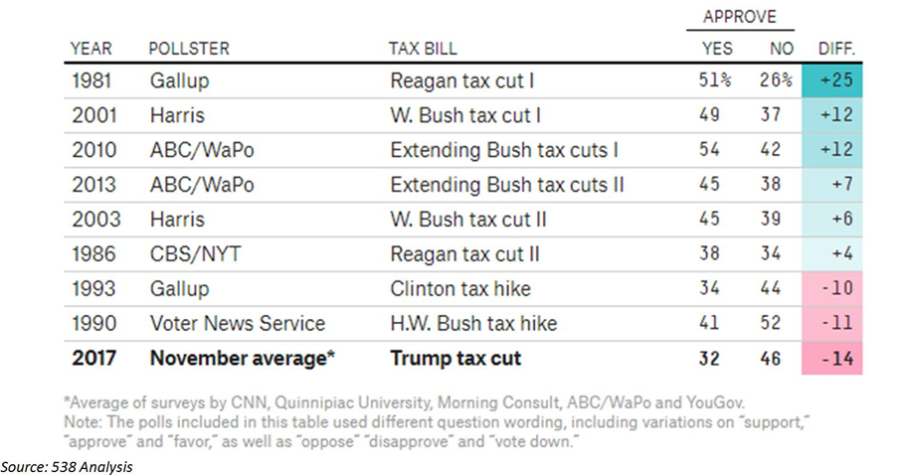
Republican Corporate Tax Give Away is Historically Unpopular

Slide 27

Welcoming the tax cut battle
From what you know, do you support or oppose the tax cut for corporations and individuals passed by the Republicans in Congress and signed by the President at the end of last year?
CHANGE IN SUPPORT FOR TAX CUT
Strong Support
Unsure: 23
Unsure: 10
+3
+2
Strong
Oppose
January 2018
April 2018

Slide 28
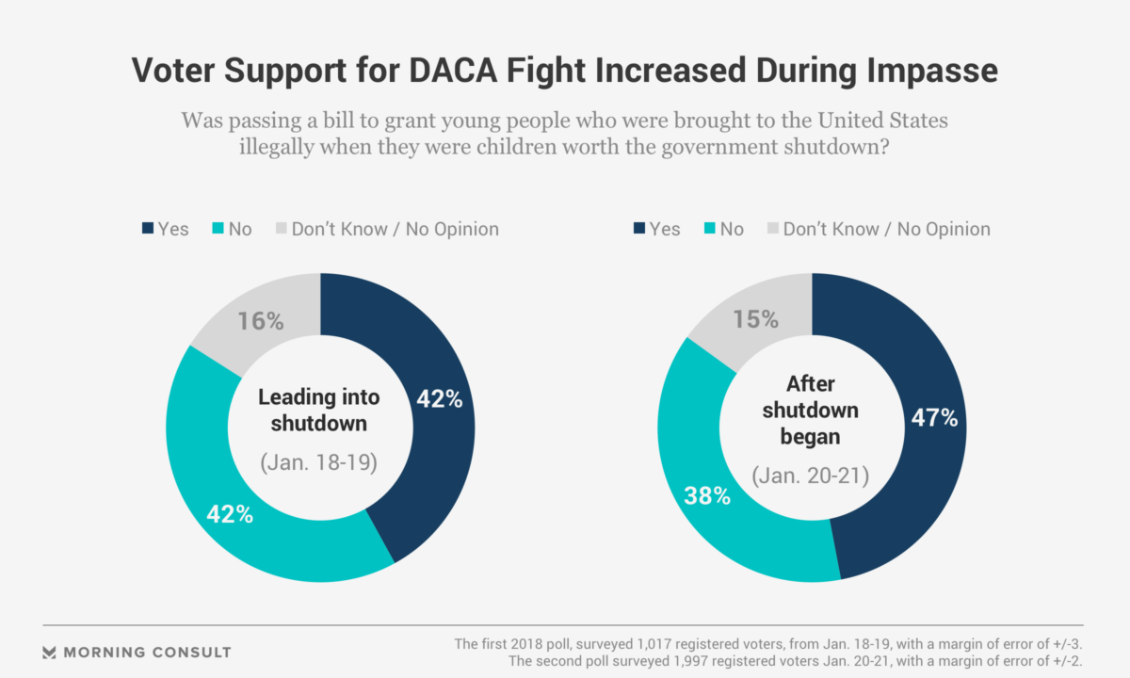
DACA and the Shutdown

Slide 29
Republican Tax Plan Historically Unpopular, but….
Approval of Trump handling of economy is over 50%.
Trump, Congress and Republican Governors are doubling down
Republican Strategic Decisions
  Aligning closely with Trump
  Pursue partisan agenda
Republicans have chosen to empower rather than constrain Trump

Slide 30
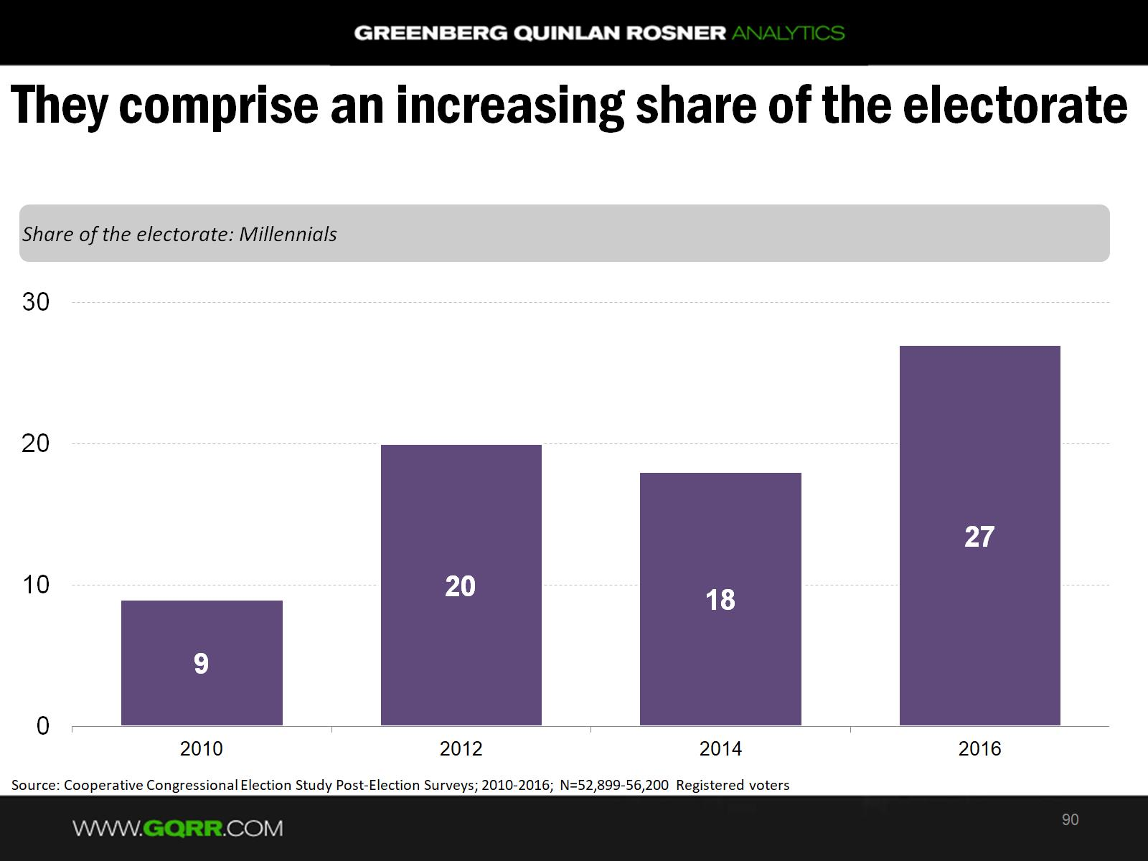

Slide 31
POLLING ON GUN REGULATION
Polling on gun regulation
Do you support or oppose stricter gun laws in the United States? (Quinnipiac, 2018)
■ Support ■ Oppose ■ Don’t know
Gender
Party affiliation
Race
Sources: “U.S. Support For Gun Control Tops 2-1, Highest Ever, Quinnipiac University National Poll Finds; Let Dreamers Stay, 80 Percent Of Voters Say” Quinnipiac University Poll, February 20, 2018.
March 30, 3018 | Kathryn Pentz & Shruthi Ashok

Slide 32
2018 Election Discussion
The Environment
The Issues
The Elections

Slide 33
What’s at stake in 2018?
Governors
Going into 2017, Republicans control 33 governorships—the highest number since 1928
90% AFT members in states with gubernatorial elections.
    50%+ in Republican states with open or vulnerable seat.
U.S Senate
Need a net gain of 2 senate seats to take control of U.S. Senate
U.S. House
Democrats need to gain 24 U.S. House Seats to reclaim the House majority
23 Republicans in Districts won by HRC
Repubs have 40 seats as toss-up/lean; D’s only 9
State Legislative Chambers
State Legislative races building to 2020

Slide 34
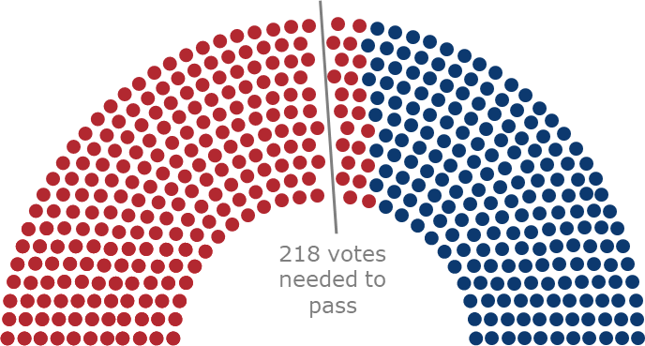
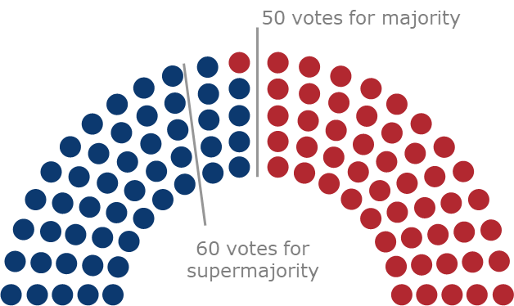
CONTROL OF CONGRESS
Democrats will need to pick up 23 seats in the House and two seats in the Senate to control both chambers of Congress
House of Representatives
Senate
Total Republicans | 240*
Total Democrats | 195*
Total Republicans | 51
Total Democrats/Independents | 49
*There are currently four vacancies in the House but they are not expected to change parties in upcoming special elections
April 23, 2018 | Daniel Stublen

Slide 35
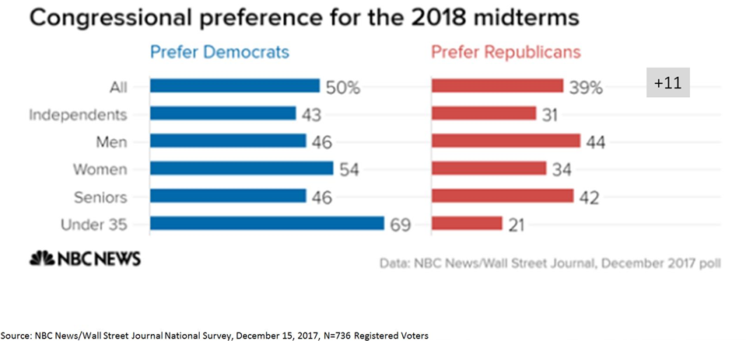
Half of Voters Want Democrats to Control Congress Next Year

Slide 36

2018 MIDTERM SENATE ELECTION
Of the 23 Democratic senators up for reelection, Trump won 10 of their states – and five by double digits
Senators up for reelection in states won by the opposing party’s 2016 presidential candidate
PERCENTS INSIDE THE STATE REPRESENT BY HOW MUCH THE OTHER PARTY’S PRESIDENTIAL CANDIDATE WON IN 2016
Clinton victory Trump victory ■ Democratic senator up for reelection ■ Republican senator up for reelection
Heidi Heitkamp (D) won in 2012 by 0.9%
Jon Tester (D) won in 2012 by 4%
Tammy Baldwin (D) won in 2012 by 5.6%
Debbie Stabenow (D) won in 2012 by 21%
WA
Joe Donnelly (D) won in 2012 by 5.7%
MT
20%
ND
36%
ME
Dean Heller (R) won in 2012 by 1.2%
OR
MN
ID
SD
WI
0.7%
NY
Sherrod Brown (D) won in 2012 by 6.0%
WY
MI
0.3%
NV
2.4%
IA
PA
0.7%
NE
IN
19%
OH
8.1%
Bob Casey, Jr. (D) won in 2012 by 9.1%
UT
IL
WV
42%
CA
CO
KS
MO
19%
VA
KY
Joe Manchin (D) won in 2012 by 14%
AZ
TN
NC
NM
OK
AR
SC
MS
AL
GA
Claire McCaskill (D) won in 2012 by 16%
AK
TX
LA
Bill Nelson (D) won in 2012 by 13%
HI
FL
1.2%
Sources: National Journal Research, 2017.
October 1, 2017 | Daniel Stublen

Slide 37
Democrats Need 24 Seats
38 Seats are “Toss-Ups” or Better
Cook Political Report ratings
■ Democrat held seats ■ Republican held seats
2017-2018 HOUSE RACES
Likely Democrat
Lean Democrat
Toss Up
Lean Republican
Likely Republican
*Incumbent not seeking reelection
Source: Cook Political Report.
January 17. 2018 | Daniel Stublen

Slide 38
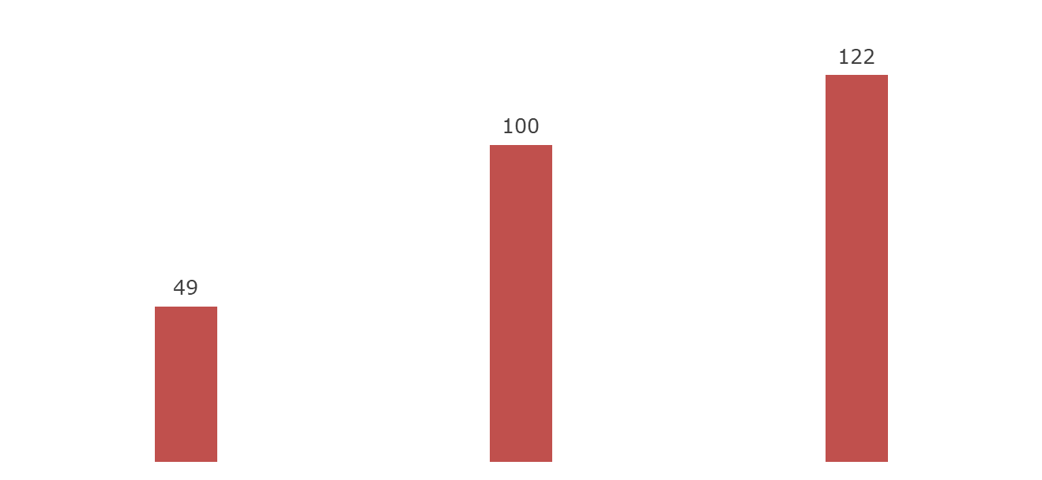
2018 ELECTIONS
Why are Republicans worried about the midterms?
House of Representatives
Current stats (3 vacancies):
  238 Republicans
  194 Democrats
Democrats need to gain 23 seats to control the House
Republican districts where Trump won by 20% or less
Republican districts that have a lower PVI than PA-18 (R+11)
Republicans who won by a smaller margin than the swing in PA-18 (R -8.5%)
Sources: National Journal Research.
April 23, 2018 | Daniel Stublen

Slide 39
2018 Governors
9 Democratic seats (3 toss up)
26 Republican seats (6 toss ups)
1 Independent (D)
17 open seats (13 Republican, 4 Democratic)
    Republicans control more governors than any time since 1928.

Slide 40
GUBERNATORIAL ELECTIONS 2017-2018
In 2017 and 2018, more governorships with Republican incumbents are up for election
Cook Political Report ratings
2017 & 2018 GUBERNATORIAL RACES
■ Dem. incumbent (4) ■ Dem. open* (5) ■ Ind. incumbent (1)
■ GOP incumbent (8) ■ GOP open* (17) ■ No election (12)
WA
MT
ND
VT
ME
OR
MN
NH
ID
SD
WI
NY
WY
MI
MA
NV
NE
IA
PA
RI
UT
IL
IN
OH
CO
WV
CT
CA
KS
MO
KY
VA
NJ
AZ
TN
NC
DE
NM
OK
AR
SC
MD
MS
AL
GA
AK
TX
LA
HI
FL
*“Open seats” are governorships where incumbent governors are term-limited or they have announced that they are not running for re-election
Sources: Cook Political Report, 2017.
October 19, 2017 | Madelaine Pisani & Daniel Stublen

Slide 41
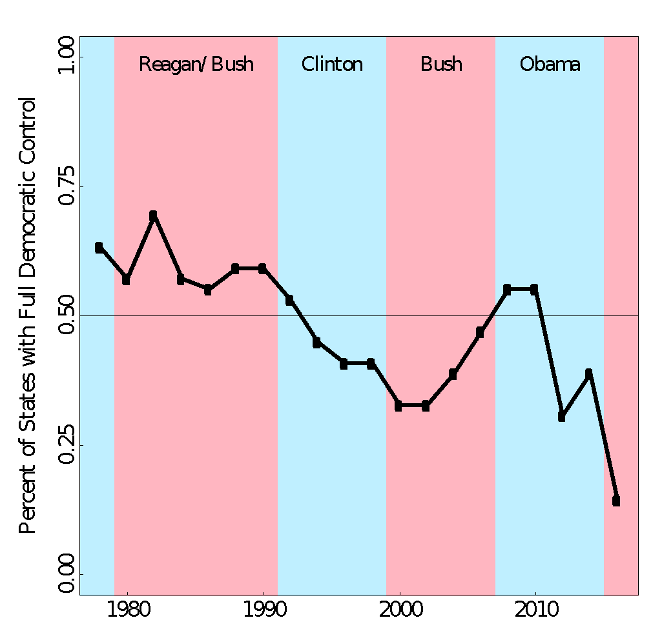

1980 to 2016: Change in State Control
Presidential
backlash
ahead?
Percent of State Legislatures with Full Democratic Control
0% 25% 50% 75% 100%
1980 1990 2000 2010 2016
Source: National Conference of State Legislatures

Slide 42
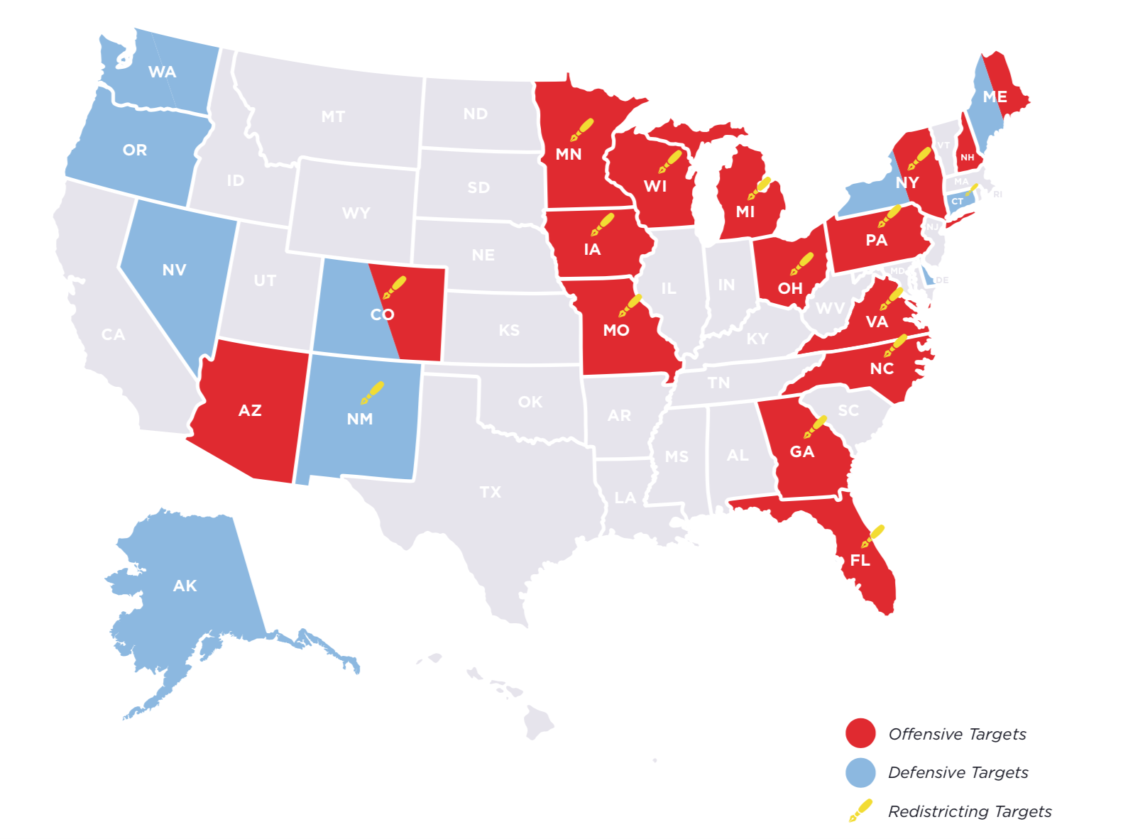
State Legislative Targets

Slide 43
Election 2018: The Mission
Restore Power to the Working People of America
Put a Check on the Policies of Donald Trump and Betsy Devos
      Take Control of At Least one Chamber of Congress
Win Governors & State Legislatures – Break Trifectas

Slide 44
2018 Program

Slide 45
Questions:
Brandon Boswell
AFT Deputy Political Director
BBoswell@aft.org

Slide 46
AHUY - Blended
A
H
U
Y
-- Who do you think is funding this case?
-- Why did the Court decide to take this case?
-- What do you think we can do change the Court?
-- How can we protect our rights”
-- Why is this happening now, so close the election?
– Register members and householders to vote
-- Volunteers to talk to other union members

Slide 47
PILLARS OF A CAMPAIGN
Social Media
WORKSITES
WALKS
PHONES
MAIL
COPE / PAC
Values / Issues

