Slide 1
Preventing Gun Violence:
The Path Forward
Gaby Witte
American Public Health Association
June 4, 2018

Slide 2
sdfaf
For the first time in decades, there is growing bipartisan consensus for sensible gun policy, a polarizing issue that has deeply divided Republicans and Democrats.
Rep. Carlos Curbelo (R-Fla.)

Slide 3
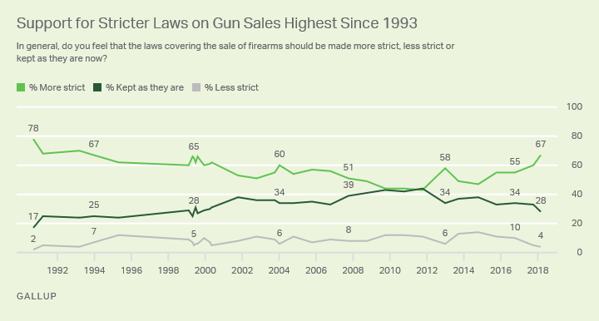
Public Support for Stricter Gun Laws
Notes:
Gallup poll
1993 - Long Island Rail Shooting
2000 - Colombine
2012 - Sandy Hook
2017 - Las Vegas
2018 - Parkland

Slide 4
Gun Violence Prevention Efforts in the 115th Congress
H.R. 4240: Public Safety and Second Amendment Rights Protection Act of 2017
S. 2009: Background Check Expansion Act
H.R. 2598: Gun Violence Restraining Order Act of 2017
S. 2521: Federal Extreme Risk Protection Order Act of 2018
H.R. 1478: Gun Violence Research Act
H.R. 3207: Zero Tolerance for Domestic Abusers Act
H.R. 5398: Increasing the age to 21 to purchase firearms
H.R. 5087: Assault Weapons Ban of 2018
S. 1945: Keep Americans Safe Act
H.R. 4268: Gun Safety: Not Sorry Act

Slide 5
What’s the path forward?

Slide 6
What do we know about gun violence?
Each year 38,000 die and 85,000 more are injured in the United States as a result of gun violence
The U.S. gun homicide rate is 25 times higher than in other affluent countries
The U.S. firearm-related suicide rate is 8 times higher than in other affluent countries
Notes:
for 15- to 24-year-olds, the rate is 49 times higher
We know that a gun in the house increases the risk of suicide
We know that a gun in the home increases the risk that someone in the home will be accidentally shot
We know that women are more likely to be killed during a domestic dispute when a gun is in the home

Slide 7
What don’t we know about about gun violence?
“
Almost everything
David Hemenway, Director of Harvard Injury Control Research Center
Notes:
https://www.hsph.harvard.edu/magazine/magazine_article/off-the-cuff-what-dont-we-know-about-the-causes-of-gun-violence-almost-everything/
We know far too little about almost every subissue in the gun discussion. We don’t know whether the federal assault weapons ban—it only lasted 10 years, from 1994 to 2004—had any effect on mass killings. We don’t know the effect of most individual gun laws, in part because the effect is probably small, since the laws are often so minor or full of loopholes.

Slide 8
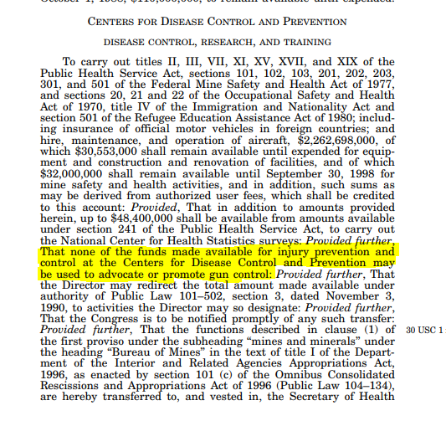
WHY?
The Dickey Amendment, 1996
Notes:
The Dickey Amendment, passed by Congress in 1996, stipulates that “none of the funds made available for injury prevention and control at the Center for Disease Control and Prevention may be used to advocate or promote gun control.”
• The amendment was introduced after NRA lobbying in response to a 1993 CDC-funded study that showed that guns in the home was associated with an increased risk of homicide in the home.
• That year, Congress re-allocated the $2.6 million budget that had been set aside for firearms research to traumatic brain injury research. • This piece of legislation has effectively halted almost all firearms research by the Centers for Disease Control and Prevention (CDC) for the last two decades.

Slide 9
In both the House and Senate, bills have been introduced to repeal the Dickey amendment and authorize $50,000,000 between 2018 and 2023 for the CDC to research firearm safety and gun violence prevention research.
H.R. 1832
Introduced by Rep. Carolyn Maloney (D-NY)
S.834
Introduced by Senator Edward Markey (D-MA)
Notes:
https://www.congress.gov/bill/115th-congress/house-bill/1832
https://www.congress.gov/bill/115th-congress/senate-bill/834/text

Slide 10
What can you do?

Slide 12
Conducting a meeting
Be on time
Be flexible
Stay on topic
Stay apolitical
Bring leave-behind materials
Be a resource

Slide 13
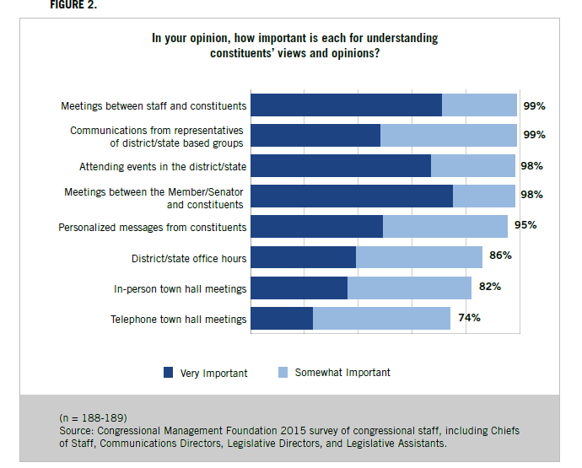
Build a relationship

Slide 14
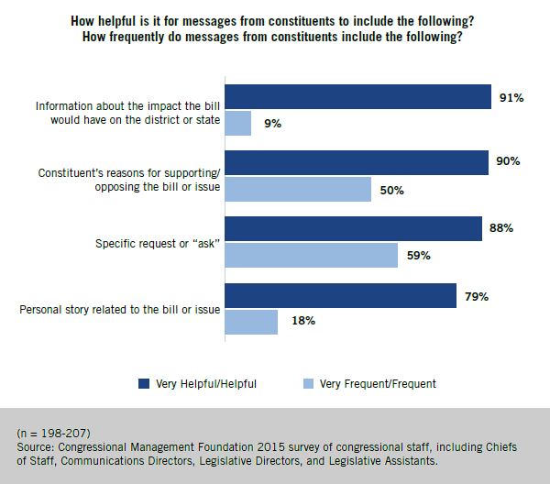
Tell your story

Slide 15
Social Media
All 100 Senators and almost all Representatives use Twitter, Facebook, and other forms of social media
78% of Congressional staffers said social media posts directed to their office from “multiple constituents affiliated with a specific group or cause” would influence an undecided Member
Find your member on social media: https://www.usa.gov/elected-officials
Using Twitter in Advocacy
“Social media is the ultimate equalizer. It gives voice and a platform to anyone willing to engage”
– Amy Jo Martin, Founder of Digital Royalty
Notes:
#SocialCongress 2015, Congressional Management Foundation, 2015. http://congressfoundation.org/social-congress-2015
Use a hashtag

Slide 16
Do what you can, where you are, with what you have.
“
”
- Teddy Roosevelt

Slide 17
Questions?

Slide 18
About APHA
The American Public Health Association champions the health of all
people and all communities. We strengthen the profession of public
health, promote best practices and share the latest public health
research and information. We are the only organization that influences
federal policy, has a nearly 150 year perspective and brings together
members from all fields of public health. Learn more at www.apha.org.
Gaby Witte
Senior Manager, Government Relations
Gabriella.witte@apha.org
(202) 777-2513

