Slide 1

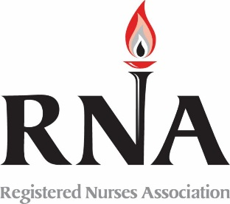
New Member Orientation
Welcome!

Slide 2

Why did we choose Nursing
To help people
To effect change in healthcare delivery
Stable industry and potential for job growth
Lifestyle (flexibility in scheduling)
Job benefits (pay, benefits; etc.)

Slide 3
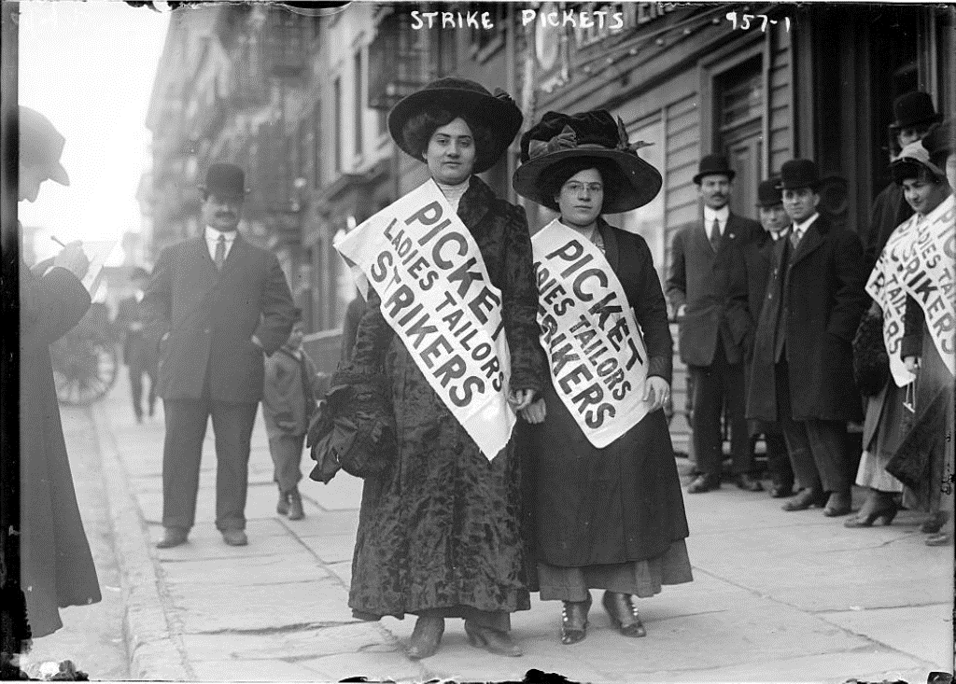
What does this have to do with unions?

Slide 4
Community of Colleagues
It’s about an association of nurses being active and getting involved, not just paying dues. Its about participating together to provide a strong cohesive force.
Join a community of colleagues vs buying insurance for protection.
Your success on the job is a priority of your union and an important part of my job as a union activist.

Slide 5
Unionized Nurses Advocate for patients, for each other, and for the profession
Nurses advocating for quality care
Nurses advocating for safe & professional practice
Nurses advocating for jobs great nurses seek

Slide 6
Nurses with a unified voice have power to make things happen!
Youngstown Hospital Lockout

Slide 7
Prevalent Topics
Staffing
  Nurse to patient ratios
  Skill Mix / Cross training
  Assistive personnel
Hours of work
  Shift length
  Mandatory overtime
  Rest and meal breaks

Slide 8
Prevalent Topics
Health and Safety
  Occupational accident and disease
  Protective equipment
RN Role in Care Delivery
  Delegation and flow of responsibility
  Documentation and other practice issues
  Clinical Ladders and other growth incentives

Slide 9
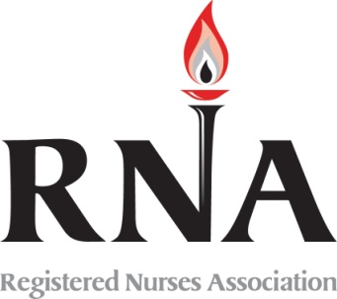
Our Local Unit is …
One of 28 ONA local units
The decision to organize was made on April 23, 1973. RNA continues the purpose of those nurses in 1973 who took the chance and made the working conditions better at General Hospital.

Slide 10
RNA Contract…
Article7
Probationary Period
Article 9
Holidays
Article 11
Hours and Scheduling
Article 16
Seniority
Article 17
Salary and Economic Benefit

Slide 11
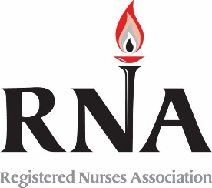





RNA and the Bigger Picture…

Slide 12

What is ONA?
The Professional Association for
Registered Nurses in Ohio.
Established in 1904 to secure the Nurse Practice Act
  Most trusted voice for the profession of nursing
  100% RN membership
  both union and non-union
Governed by Registered Nurses
Notes:
Key Discussion Points:
Inform attendees that:
ONA is the largest Professional Association for Registered Nurses in Ohio;
ONA’s founding purpose was to secure Ohio’s Nurse Practice Act, the law that regulates nursing practice in Ohio;
Because of ONA’s sound reputation and strong advocacy, ONA is the most trusted voice for the nursing profession;
ONA is an organization devoted exclusively to Registered Nurses, both unionized and unrepresented nurses come together to make the most powerful voice for nurses in Ohio.
Tell attendees that ONA is truly a RN-driven organization. Explain ONA’s governance structure to attendees:
ONA House of Delegates is the ultimate decision-making body
Required to be all RN’s
Elected Board of Directors is charged with governance between House of Delegates meetings (held biennially)
Required to be all RN’s

Slide 13
New Members
Providing a personal connection
  2 weeks
  6 months
  Quarterly meet and greet
Please feel free to reach out to the officers or your unit steward at anytime
  Concerns/ Issues
  Policies/ Contract
  Information/ Understanding
We are here for each other

Slide 14

Membership Applications
Completing your
Membership Application and
Dues Deduction Form
is the first step toward active ONA membership.
Come join our community of colleagues.

Slide 15


Our Local Unit Leaders are …
President- Jeannette Porter (926-2156)
Vice President- Robert Weitzel (926-2161)
Secretary- Brian Burger (748-6246)
Treasurer- Ken Harris (926-2160)
Assistant- Jill Claire
Office Hours
Monday, Tuesday, and Thursday (officers)
Wednesday 1000-1400 (assistant)
Labor Rep- Bob Holt (614-448-1033)
Organizer- Dan Whitehurst (614-448-1021)

Slide 16


Check us out on the WEB…
RNA Home Page
www.cincynurses.org

